Slide 1
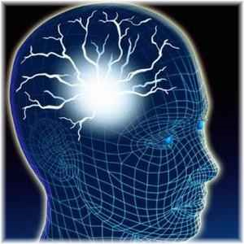
Science of Subtle Energy
Presented on Thur Jan 20, 2011
Café Metaphysics
By Douglas Matzke, Ph.D.
doug@QuantumDoug.com
http://www.QuantumDoug.com

Slide 2
Abstract
Healers and intuitives talk about subtle energy. But what exactly is subtle energy and why has science not said much about it? This presentation discusses what is subtle energy from quantum information science and spiritual perspective. We will have exercises that demonstrates the reality of subtle energy. Join me as we play with and explore these consciousness expanding ideas.

Slide 3
Biography
Doug Matzke has a Ph.D. in quantum computing, has studied NLP for the last 5 years and has studied metaphysics topics for over 30 years. Doug creates an interesting synthesis of computation models of consciousness and spiritual ideas by using quantum science based arguments as a bridge to spirited science conclusions. He is an enthusiastic and thought provoking speaker.

Slide 4
Outline
Science of Subtle Energy
What is Subtle Energy or Chi
Chi and Measurement
Experiencing Chi
Chi Generators
Double Blind Experiment
Chi and Intelligence/Information
Chi and Thoughts (Exercise)
Chi and Quantum/space/time
Expanding your Chi (Meditation)
Questions and Discussion

Slide 5
What is Subtle Energy or Chi
Chi is the life force
Chi is like flowing water (not a lake or battery)
Chi is free (no reason to stock pile or hoard)
Chi is ubiquitous (everywhere in nature)
Chi is not measurable (not classical energy)
Chi is informative (not energetic)
Chi is connective (non-local in space and time)

Slide 6
Chi Science History
Thousands of years old in Eastern countries
– Basis of medical, military and spiritual world views
Acupuncture surgery in west only in 1960s
Systems: acupuncture meridians, chakras, Iching
Imprinting in water: succussion, vortex
Awareness: dowsing, medical intuition, RV
Effects: Reiki, energy balancing, REG PK
Modern research laboratories (Pear, IONS, Sony, etc)

Slide 7
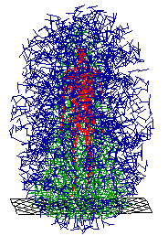
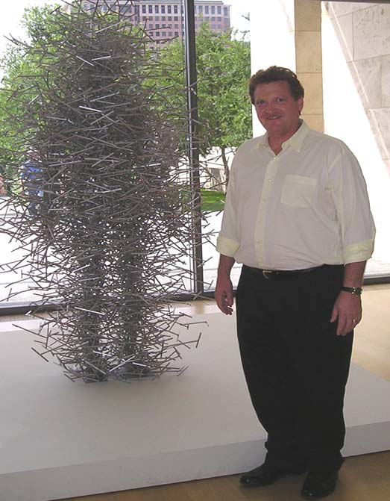
Structure of Chi ‘Field’
Non-classical Quantum Field
Quantum Cloud: Representation of high dimensions projected into 3 dimensions

Slide 8
Limits & Classical Information
Speed of Light
Uncertainty
Observability
Determinism
Density
Black holes
Relativity and Gravity
Consistency and Conservation
Undecidable and NP completeness
Locality based on number of dimensions
Dimensional projection/embedding
Observer Frame(s) as computation perspective

Slide 9
Chi and Science
Scientists can generate Chi
Chi generators
Chi amplifiers
Vortexes and succussion
Acupuncture regulates Chi
Hands on Healing
Scientists can not measure Chi
Only humans can sense Chi
No cameras, nor devices
Limited by model of Chi

Slide 10
Experiences of Chi
Subconscious
Chill, tingling, hair raising
See auras, colors, geometric patterns, emotions
Direct knowing: thoughts, telepathy, parlor game
Scale/distance: occult chemistry-anu, RV
Outside time: in the zone, clock medit, precognit
Intent: copper wall, healing, effects electronics
What are your experiences?

Slide 11
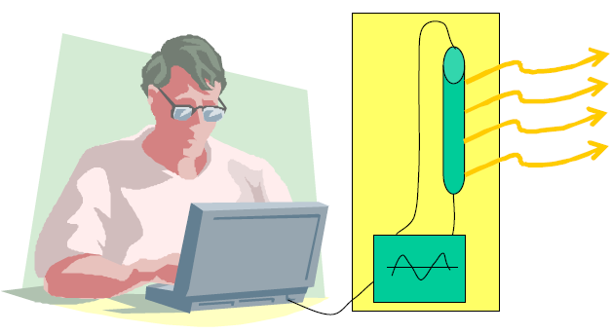
Chi Generators Using Light
Computer controlled modulated light source
Modulated ions using noble gases in miniature bulbs
Audio band frequencies – primitive frequency/shapes
Human subjects for validating pattern effects
Hundreds of patterns or “programs” possible

Slide 12
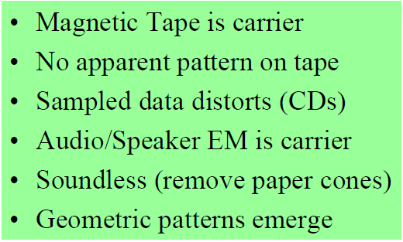
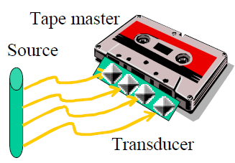
Chi Tapes and Speakers

Slide 13
Experiencing Chi Tapes
my first hand accounts with tapes
Major responses
No awareness at all
Mild tingling or fleeting thoughts
Strong and unsettling
Extreme sensitivity and knowledge of energy patterns
Experiences with playing tapes
“Just don’t aim it directly at me!!”
Health fair overdose
Three-five minute exposure effects felt for hours (or days)
Experiences with holding tapes
Blue Light Special
Electromagnetic sensitive
Chi Master calls generated pattern “Master Chi”
Play a tape: both sides

Slide 14
Double Blind Experiment
Premise that tapes contain pattern: unplayed
Blind randomize/seal target and two controls
Experience or connect with tape pattern
Write impressions, reason & score (#1,#2,#3)
Judges will tally results of ranking
Open sealed containers and reveal contents
Discussion of impressions

Slide 15
Chi and Intelligence/Information
More like information than energy
Contains meaning and thoughts
Information is related to energy/mass
Subtle energy is a misnomer so:
Prana, Mana, Ki, Chi, etc
Subtle information
Intelligent energy
Chi is my preferred name

Slide 16
Information is Physical
Black Hole event horizon (inside is a singularity with no space nor time)
Quantum Information is consistent with Black Hole Mechanics
Bits as entropy (Planck's areas on surface)
M➔E➔Info
Wheeler’s “It from Bit”

Slide 17
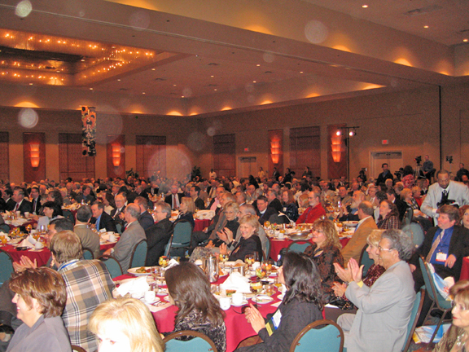
Example of Orbs

Slide 18
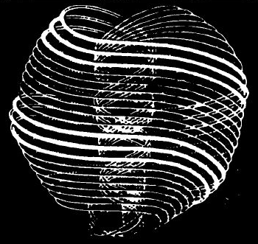
What are Thoughts
Thoughts are quantum Things! (not classical things)
Thoughts are both affect/effect
Are both/neither states/actions
Related to structure/topology (Anu and Rotes)
Thought bubble as quantum field
Spreads outside physical body
Awareness, attention, intention
Knowing, understanding, meaning
Memory forms emotional state dependent locality
Remember/access thoughts from anywhen

Slide 19
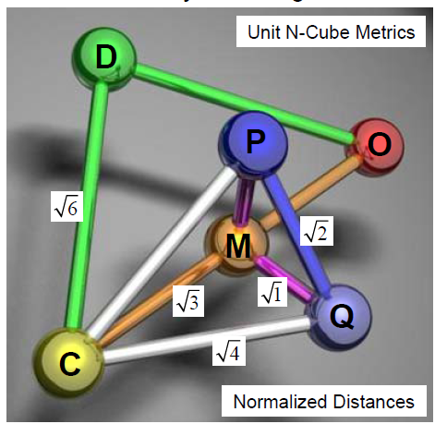
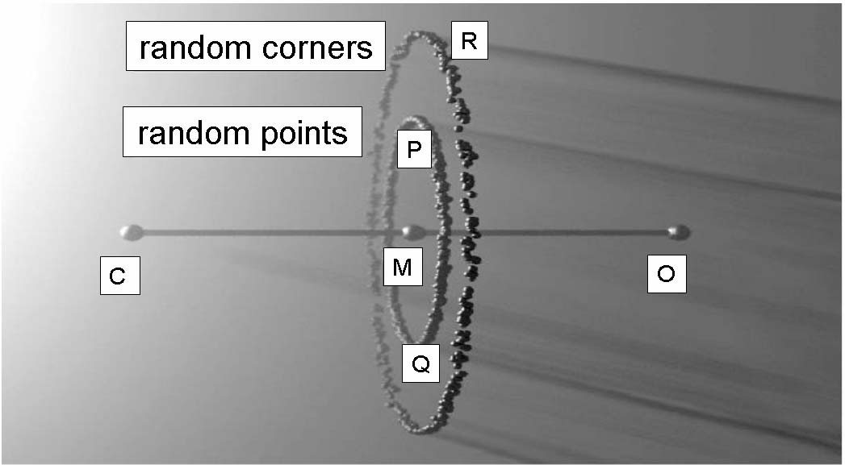
Representation of Thoughts
Random Points: correlithms

Slide 20
Thoughts and Meaning
Human meaning inside mind but project “out there”
Meaning are locations in hyperspace (focus levels)
Content addressable memories
Common sense local relationships
Understanding
Knowing
Meaning
Abstraction and Archetypes
Akashic records
Telepathy based on some universal meaning
Animal/plant/nature communication
Unconscious optimization and Gestalt answers

Slide 21
Chi and Thoughts (Exercise)
Group Exercise (10 per group):
Volunteer with back towards audience
Rest connect with intent to that person
Rest of group then reports thoughts about person

Slide 22
Chi and Quantum/space/time
Your choice of model understanding: (massless)
Point/address in set of dimensions: easy to see
Include collections of dimensions: allows void
No distance metrics
Coefficient/address is not classical distance
Semantics relationships are metrics of distinction
Primitive change without time
Changes of state without any universal clock
State changes represents complexity increase
Related metrics (no velocity, energy, mass, etc)
Computing without energy (all infor in right location and form).
Ordering increases complexity (No entropy or negative entropy)

Slide 23
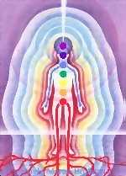
Quantum Mind Model
Thoughts are made of the strands of source
State space is outside of 4D spacetime
Very high dimensional state space
Randomness is key resource
Quantum style orthogonal states
Probabilistic state combination
CDMA style computational framework
Dimensional increase due to superposition/entanglement
Semantic relations exist & can be constructed
Brain/mind mapping using phase invariance (patent)

Slide 24
Expanding your Chi (Meditation)
Guided meditation to open all your chakras in a group setting.
At end try Energy Combing

Slide 25
Chi in Your Daily Life
Chi is generated by normal things
Florescent lights
Plucking/banging musical instruments
Clapping
Vibration and sounds
Thoughts
Grounding
Keeping chakras open (positive thoughts)
“Let it be” tree
Getting Cleared (Self clearing, QCS, Reiki etc)

Slide 26
Questions and Discussion
Open Sealed Envelopes Now
End of Presentation

