Slide 1
Proto-physics the link between Quantum Physics and Metaphysics
Presented on Thurs Nov 17, 2011
Café Metaphysics
By Douglas Matzke, Ph.D.
doug@QuantumDoug.com
http://www.QuantumDoug.com

Slide 2
Abstract
Physics and information science have a lot to say about connecting quantum physics to metaphysics. This quantum related science is best described as proto-physics, since the very high dimensional features connect these two subjects and are the source vibrations under everything and no-thing. 'Quantum Mind', 'It from Bit‘ and 'thoughts are quantum things‘ will be some of the subjects discussed.

Slide 3
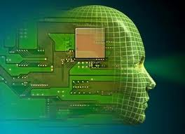
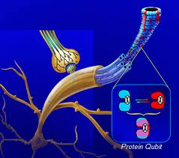
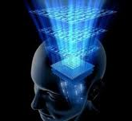
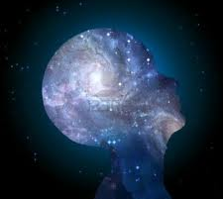
Brain/Mind/Spirit Model Continuum
Classical Brain
Mind is brain state
Dualistic Brain/Mind
Mind requires Brain
Brain is Transceiver
Quantum/Spirit Mind
Classical
Quantum
Spiritual
Brain is Computer
Neurons are Coherent
Brain is Transceiver
Self as Eternal Spirit
3d Space/ 1d Time
Matter/Energy
Locality & Conservation
Neuron Connectivity & Parallelism
Quantum State Spaces
Change without Time
Information & Probabilities
Law of Attraction & Supermind

Slide 4
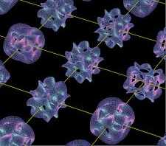
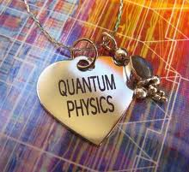
Physical & Protophysical Models
Classical Physics Properties
Matter/Energy, Mass, Space/Time
Black hole physics ties Relativity & Quantum
It from Bit, Sciences of very big and very small
Quantum Physics Properties
State Spaces, Exponential Speedup
Metaphysics and Chi Research
Non-local space/time awareness and healing states
Spiritual and Manifestation
Law of Attraction and divine states
Everything is quantized when very small, even space & time

Slide 5
Information is Physical
Quantum Bits are consistent with Black Hole Mechanics
Black Hole event horizon (inside is a singularity without space and time)
Bits as entropy (Planck's areas on surface)
M➔E➔Bits
Wheeler’s “It from Bit”

Slide 6
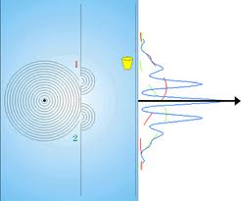
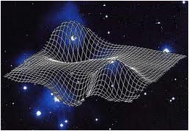
Classical Physics Properties
States of Matter
Solid, liquid, gas, plasma, atomic, quarks
Forms of Energy
Temperature, heat, complexity, thermodynamics
Chemical & nuclear bonds, phonons, photons
Potential energy, gravity, zero point energy
Space and Time
Classical space-time, computational space-time
Relativistic space-time, black hole singularity
Quantum space-time (Shor’s Algorithm)
Physical Limits
Density, heat, speed, frequency, noise, complexity, representation
Reductionist down to quantum properties

Slide 7
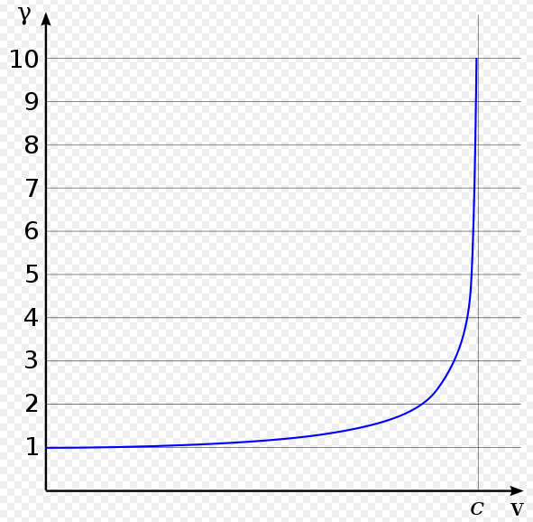
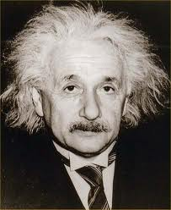
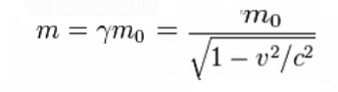
Relativistic Space-Time
Lorentz Factor
Time Dilation
Length Contraction
Relativistic Mass
Near the speed of light: distances are longer, clocks run slower and masses are heavier than the rest mass.

Slide 8
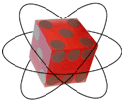
Classical vs. Quantum Bits
Topic | Classical | Quantum
Bits | Binary values 0/1 | Qubits
States | Mutually exclusive | Linearly independ.
Operators | Nand/Nor gates | Matrix Multiply
Reversibility | Toffoli/Fredkin gate | Qubits are unitary
Measurement | Deterministic | Probabilistic
Superposition | Code division mlpx | Mixtures of
Entanglement | none | Ebits

Slide 9
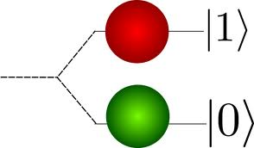
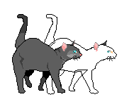
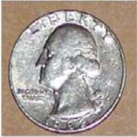
Quantum Bits – Qubits
Classical bit states: Mutual Exclusive
Quantum bit states: Orthogonal
State1
180°
-
spin ½
90°
-
+
State1
State0
+
State0
Classical states co-exclude others
Qubits states are probabilistic

Slide 10
Quantum Space-Time
Qubit (Quantum Bit)
Superposition (q*2 states)
Unitary ops & measurement
Qureg for ≥2 Qubits
Tensor Product (2^{q} states)
for q=200 then 1.6 x 10⁶⁰ states
Ebit for ≥2 Qubits acting as 1
Entanglement
Separated but states act as one
Non-local correlated states (EPR/Bell/Magic)


Slide 11
Quantum Computing Speedup
Peter Shor’s Algorithm in 1994
Quantum Fourier Transform for factoring primes
New quantum polynomial time complexity class
space
space
space
time
time
time
Spatially bound
exceeds universe life
Temporal bound
exceeds black hole
Quantum polynomial
time can solve it.
classical
relativistic
quantum
Solutions to some problems don’t fit in the classical universe!!

Slide 12
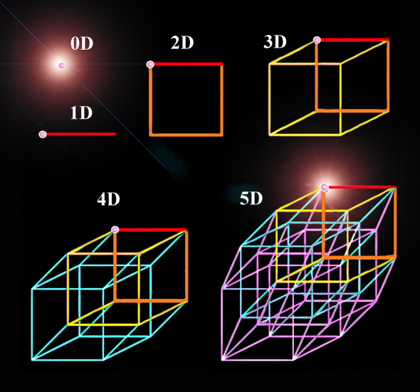
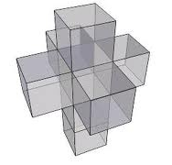
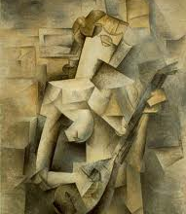
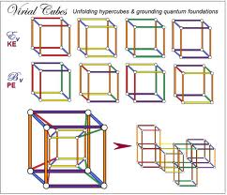
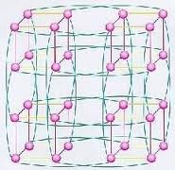
High Dimensional Topologies
Start Animation

Slide 13
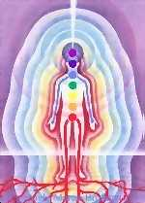
Quantum Mind Model
Thoughts are dimensional strands of source
State space is outside of 4D spacetime
Very high dimensional state space
Randomness is key resource
Quantum style orthogonal states
Probabilistic state combination
CDMA style computational framework
Dimensional increase due to superposition/entanglement
Semantic relations exist & can be constructed
Brain/mind mapping using phase invariance (patent)

Slide 14
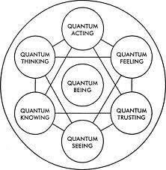
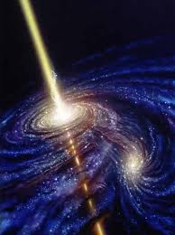
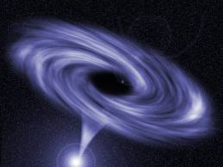
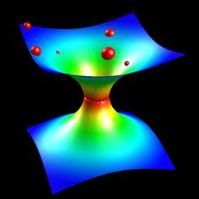
Thoughts are Quantum Things
Thoughts are ‘Things’
Information is Physical
Wheeler’s ‘It From Bit’
Thoughts affect probabilities
Thoughts have an effective mass/energy
Source that creates worlds

Slide 15
Inclusion Based Universe
Each dimension is own meaning (vibration)
Each Dimension represents both X and Not X
Not X ≠ Y
Quantum state space
X
90⁰
Not Y
Y
Not X
This is quantum State Space used by Light

Slide 16
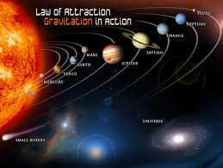
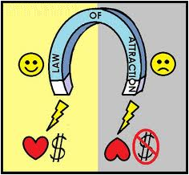
Law of Attraction as Physics?
Attraction Information Properties
Likeness = Nearness
Address is Meaning
Attraction is like gravity wells
Attraction is monopole ➔
Polarity is Energy Centric
Dimensional Inclusion
Dimensions are bits & complexity
Inclusion of semantics/meaning
Semantic network topologies

Slide 17
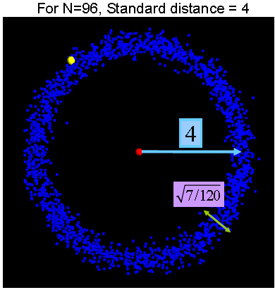
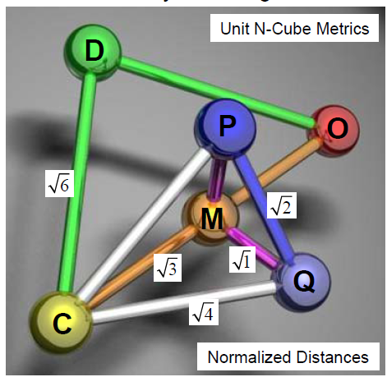
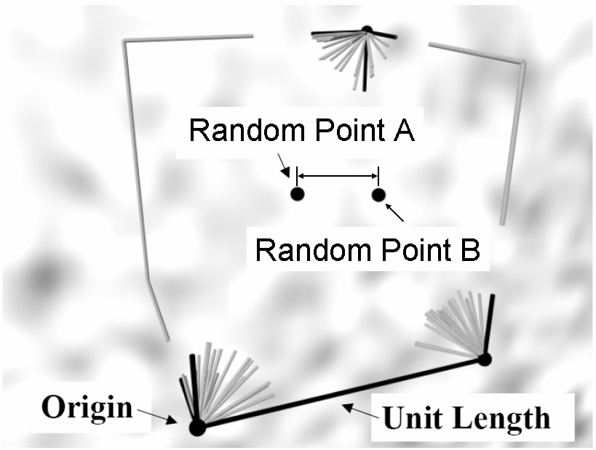
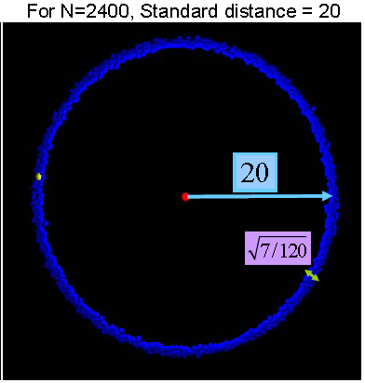
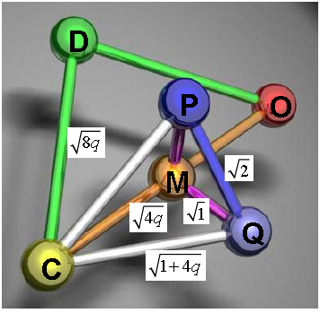
Math of Thought Dimensions
Thought Point A
Thought Point B
Quantum Topology
Corner?
inclusion box

Slide 18
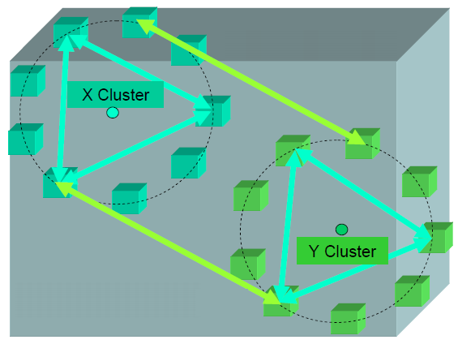
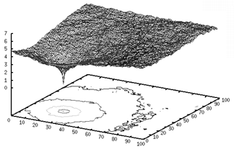
Vortices and Thought Mass/Energy/Bits
‘Like’ thoughts are semantically ‘near’ each other in localized clusters of ‘like’ thoughts

Slide 19
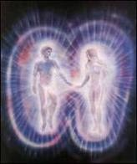
Beings of Light Protophysics
Space oriented behaviors
Vibration without classical metrics
Ubiquitous
Connectedness
Unity and oneness
Collective Beings
Out of Body and Ascension
Time oriented behaviors
Eternal and timelessness (before time itself)
Total experience without sequences/language
Experience different time rates – proto-time
Change/evolution without time
Quark or Anu?

Slide 20
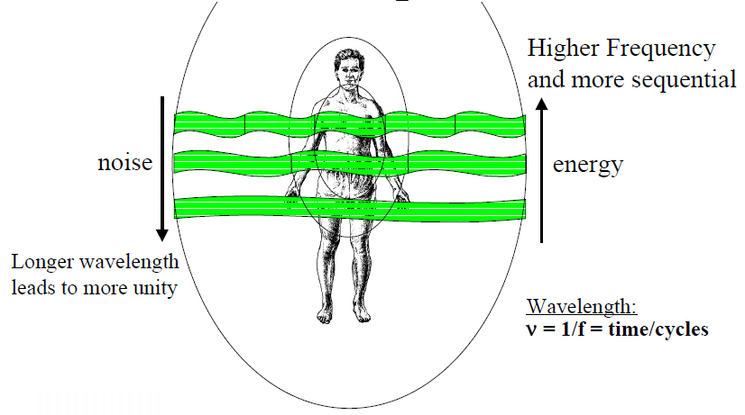
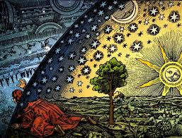
Quantum Mind Paradoxical Metrics
Wavelength determines Size of ‘Now’ Bubble

Slide 21
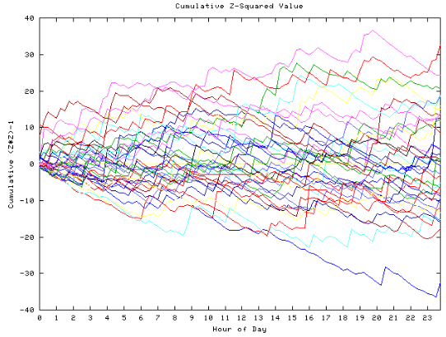
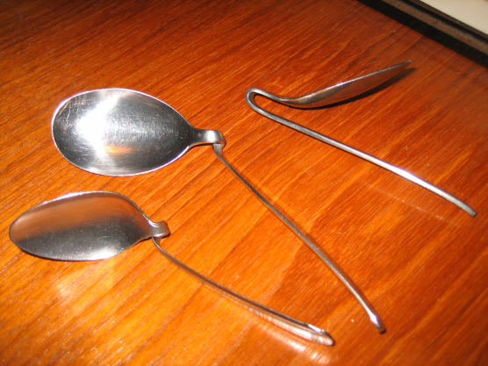
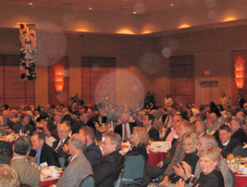
Humans Affecting the Physical World
Physical affects research
Global Consciousness Project (on 9/11) →
Copper Wall
Mind affecting electronics
Spoon Bending →
REG, RNG & PK experiments
Teleporting
Orbs affect cameras →
Manifestation
…

Slide 22
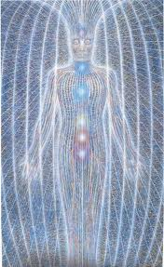
Human Being Energy Behaviors
Subtle Energy/Chi oriented behaviors
Anchoring, squashes, phobia cures & reframing
Grounding, balancing & clearing (QCS)
Breathing and breath works
Reiki and healing sciences
Remote healing
Subtle energy generators
Auras, chakras, meridians, homeopathy,
…

Slide 23
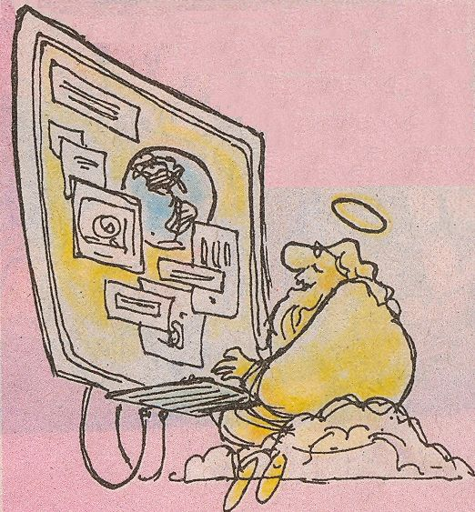
Beings of Light Energy-Info
Information/meaning oriented behaviors
Everything is Awareness, Consciousness & Intelligence
All knowing and direct knowing/remembering
Direct experience without language
Universal Meaning without language
Thought without brain and no-thought
Akashic Records and Master Teachers
Touch the Divine & exceptional experiences
Energy
All Powerful
Emotion is thought amplifier (love, joy, peace, divinity)
Thought/emotions can affect the brain/world
Kundalini awakening, transcendence

Slide 24
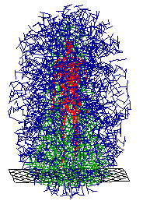
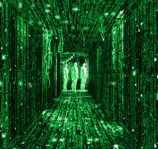
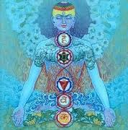
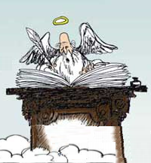
Quantum Dimensions Protophysics Summary
Quantum Dimensions (QDs) are root to every ‘thing’:
QDs are proto-physical basis of classical space-time
Classical world derived from QDs information properties
Empty Space & Black holes derived from QDs
QDs are information/intelligence and meaning
Light derived from QDs
Beings of Light are collections of ‘intelligent’ QDs
Models of God have evolved with science advances

