Slide 1
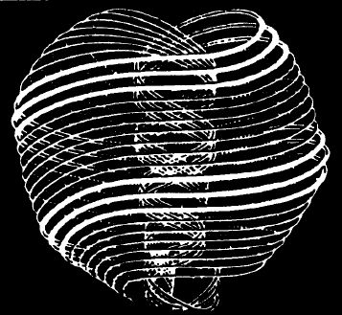
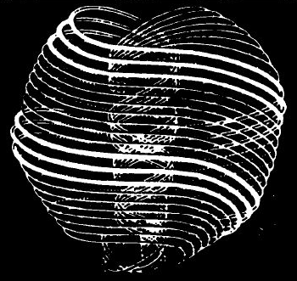
Quantum Physics and Metaphysics: If God used information/computing
Presented on Tues Jan 26, 2010
Café Metaphysics
By Douglas Matzke, Ph.D.
doug@QuantumDoug.com
http://www.QuantumDoug.com

Slide 2
Abstract
Did you ever wonder how thoughts can affect the physical world? Where is meaning in thoughts? These questions are part of the story how metaphysics and quantum physics are interrelated at a pre-physics or proto-physical level, using primarily information concepts. These complex topics are understandable once we explore that the mind and thoughts are really quantum information supported by high dimensional quantum vibrations. These ideas are so fundamental to everything, we'll explore them by considering that God most likely used information-like mechanisms to create all behaviors we observe and experience in both quantum physics and metaphysics. Join me as we play and explore with these consciousness expanding ideas.

Slide 3
Biography
Doug Matzke has a Ph.D. in quantum computing, has studied NLP for the last 5 years and has studied metaphysics topics for over 30 years. Doug creates an interesting synthesis of computation models of consciousness and spiritual ideas by using quantum science based arguments as a bridge to spirited science conclusions. He is an enthusiastic and thought provoking speaker.

Slide 4
Outline
God’s use of information/computing
Definitions of God, Information, Quantum and Metaphysics
In the Beginning, Does God need information?
Quantum Mind Model
Information and Meta Physics and Protophysics
Duality and Paradoxes
Quantum and Neuro-Linguistics Programming
Space/time/Energy models
Information, Mind, Thought and Meaning
Limits
Vibration
Thoughts
Meaning
Law of Attraction
Meaning of Model
World View
Choose your emotional State
Reaching Infinite Intelligence
Summary and Conclusions

Slide 5
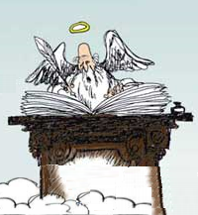
Working definition of “God”
Term “God” has many names (some samples):
The One
I am
The divine, holy, sacred, spirit, …
The Source (of joy, peace, love, …)
The Creative Spark
The Unknowable
…
Expected properties of “God” (some samples):
Oneness and Unity
All Powerful (energy concept)
All Knowing, Infinite Intelligence (information concept)
Transcends space and time
Ubiquitous
Created the universe from “nothing”
In all living things (Gaia, chi, etc)
The ultimate engineer, physicist, computer scientist, artist, …
God with Book
Notes:
King, lord, trinity, priest, Jesus, Yahweh, spirit, Allah, Vishnu, Krishna,

Slide 6
Some Quantum Physics Terms
Protophysical information system (non-classical):
Precedes & can not be modeled in classical physics
Mechanism for zero-point energy and black holes
Uncertainty Principle & quantum noise (Pauli spin matrices)
Particle-Wave Duality and quantum discreetness
High dimensional mathematics (bigger than 3D or 4D or even 12D)
wave functions, Probability Amplitudes, Probabilities, many worlds
Quantum Tunneling
Unitary, reversible, singular/invertible, EPR Paradox, Bell’s Theorem
Qubits, ebits (quantum computing)
Superposition, Entanglement and quantum measurement
Quantum non-locality (Bell and Magic States)
Quantum algorithmic speedup (Shor’s algorithm)
Paradigm shift: information vs. energy duality

Slide 7
Information is Physical
Black Hole event horizon (inside is a singularity with no space nor time)
Quantum Information is consistent with Black Hole Mechanics
Bits as entropy (Planck's areas on surface)
M➔E➔I
Wheeler’s “It from Bit”

Slide 8
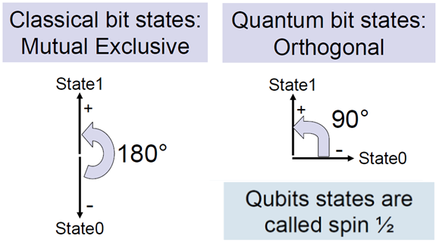
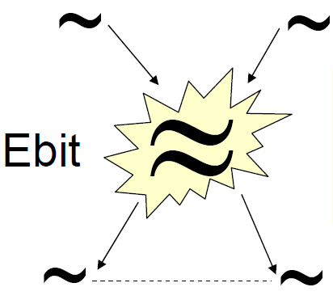
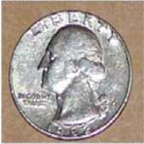
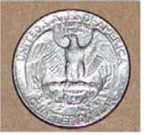
Key Quantum Properties
Classical
Quantum
Bits
QuBits
eBits
Orthogonal states: Superposition
Multiple qubits: Entanglement
Separated but Oneness States

Slide 9
Some Metaphysics Terms
Information based behaviors:
Awareness
Remote Staring
Telepathy, Intuition and Déjà Vu
Transcendent Thought (super Mind), Ascension
Perception
Remote Viewing, Astral Projection and Occult Chemistry (Anu)
Applied Kinesiology (Muscle Testing)
Clairvoyance , clairaudience, clairsentience, claircognizance (and other modalities)
Knowing
NDE, In the Zone
Medical Intuition
Channeling
Energy based behaviors:
Change of Physical States:
REG manipulation
Changes in brain & other living systems
Energy Medicine, Healing, Breath Work (chi, prana, mana, etc)
Heating/cooling of objects, negative entropy, time manipulation
Movement of Physical objects:
Psychokinesis or telekinesis
Levitation
Teleportation
Manifestation of physical objects
Many of these listed behaviors can be either local or remote in either space or time!
Don’t forget: Brain and Mind interaction for Thoughts

Slide 10
Common ProtoPhysics
Protophysics means :“first, foremost or earliest form of” physics
 | Quantum Physics | Metaphysics
Informational | Probabilistic, qu-speedup | Law of Attraction, Supermind
Primitives | Dimensional strings | semantic strands, vibrations
Topological | Qubits, ebits, bell states | thought forms, rotes, Anu
Observable states | Not directly | Not directly (except mind)
Spatial locality | Non-locality | Non-locality
Temporal locality | Non-locality | Non-locality
Physical effects | Measurement, noise | REG and thoughts are things

Slide 11
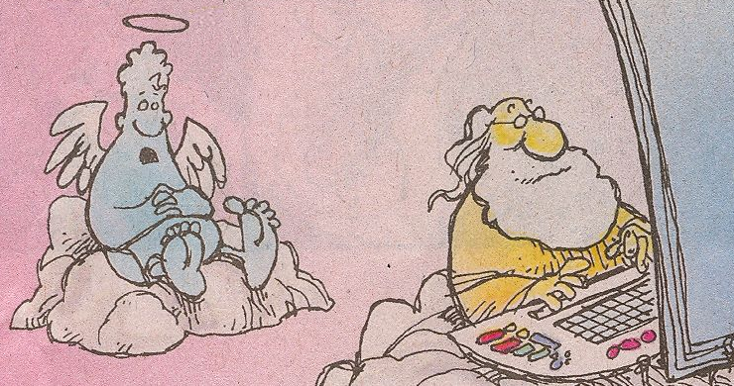
In The Beginning
Did God need information technology to create the universe?
Most Likely the answer is Yes! That “order” was God itself.
Mechanism behind the laws, conservation, behaviors, etc

Slide 12
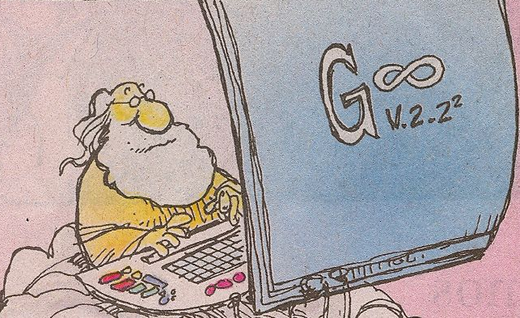
What is Source of everything?
What kind of Information did God use to create the big-bang?
Poof
Quantum states = Dimensional Strands
Quantum states: source of the bit-bang (maybe a big thought!)

Slide 13
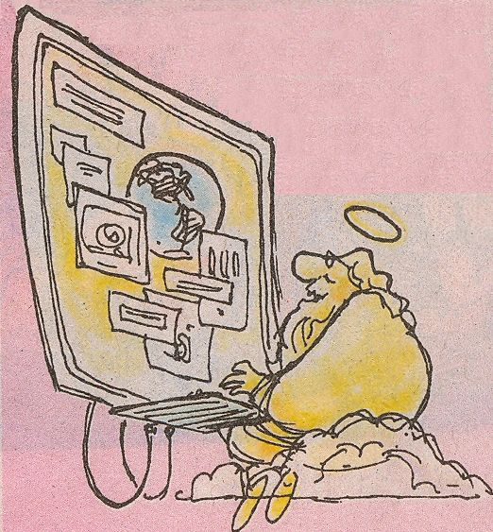
Once the universe boots up?
Forces/Matter/Energy/Time and Space all emerge from quantum foam.
Background Radiation
Zero-point energy
Black-hole mechanics
Particle/Wave Duality
Quantum superposition
Quantum entanglement
Quantum probability
Quantum tunneling
Quantum non-locality
Quantum computing
Quantum Speedup
Quantum properties still form the infrastructure for physical universe.

Slide 14
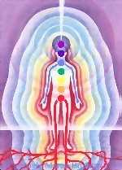
Quantum Mind Model
Thoughts are made of the strands of source
State space is outside of 4D spacetime
Very high dimensional state space
Randomness is key resource
Quantum style orthogonal states
Probabilistic state combination
CDMA style computational framework
Dimensional increase due to superposition/entanglement
Semantic relations exist & can be constructed
Brain/mind mapping using phase invariance (patent)

Slide 15
Information and Metaphysics
Start with the following extremely good presuppositions:
Mind and brain are separate but cooperating systems – quantum mind
Mind is informational and non-classical
Mind has quantum-like properties (making the brain a quantum antenna)
Mind is not limited by space and time (but more by habit)
Thoughts/Bits can affect the physical universe as equivalent energy/entropy.
Mind has metaphysical capabilities:
Remote viewing
Telepathy
Expanded awareness (NDE, clairsentience, etc)
Direct awareness, knowing and meaning
Precognition and time manipulation
Quantum Mind model is a paradigm shift for the following reasons:
Quantum States and high dimensional representation for thoughts
Requirement for Brain/Mind interface (probabilistic exchange)
Recast metaphysical topics to protophysical realization

Slide 16
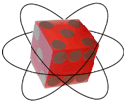
Duality and Paradoxes
Classical vs. Quantum domains
Energy vs. Information
Particle vs. Wave
Deterministic vs. Probabilistic
Continuous vs. Quantum discreteness
Conscious vs. Unconscious
Faster is smarter classically
Slower is more parallelism in quantum
Higher frequency vs. higher state
Opposites attract vs. birds of a feather
Dualities are not mutually exclusive in quantum world

Slide 17
Paradoxical Computing Metrics
Property | Choices | Contradiction
Size | Larger/Smaller | Larger is less localized
Speed | Faster/Slower | Faster is more localized
Power | Less/more | Less power is slower
Grain Size | Gates/wires | No distinction at quantum level
Dimensions | More/less | Physical vs. mathematical dims
Parallelism | Coarse/fine | Sequential vs. Concurrent
Complexity | Less/More | Makes programming hard
Noise | Less/More | Use noise as resource
Velocity | Fast/Slow | Time Dilation slows computing

Slide 18
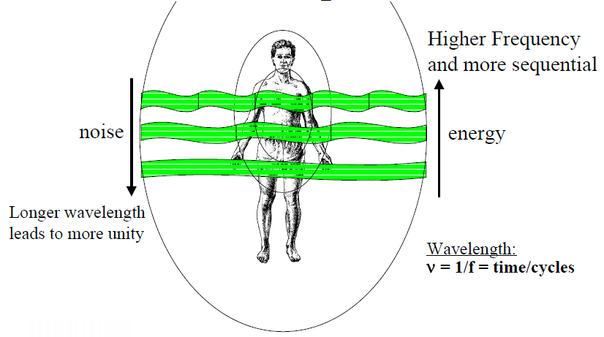
Paradoxical Nature of QuMind
Wavelength determines Size of Now Bubble

Slide 19
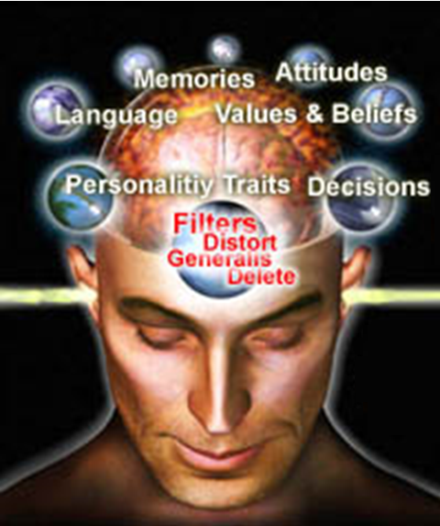
More Paradoxical Language Topics
Duality/Paradox affects language & beliefs
Subtle energy? (is energy subtle mass?)
Better Naming: Prana, chi, etc
Verbs vs. nouns
Energy vs. Information
Conservation vs. Consistency
Space vs. time
Persistence vs. Change
State vs. Operation
Memory vs. Processing
Frequency vs. vibration
Power vs. knowing
Normal vs. paranormal

Slide 20
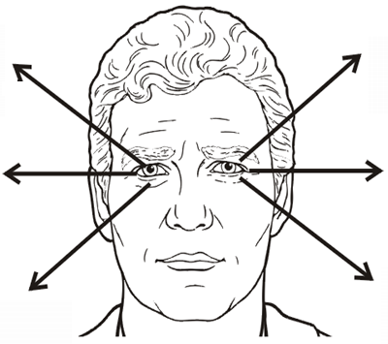
Quantum Mind and NLP
NLP – Neuro-Linguistic Programming
VAK Modalities & eye accessing patterns
Meta Models
Rapport
Anchoring
Reframing
Timeline
Archetypes and Metaphors
Conscious and Unconscious
Using language/body to access mind in the qu-bottle

Slide 21
Spatial & Dimensional Topics
Many dimensions represented by lotus flowers
High dimensional vs. holographic
Topology/Relationships/Connection
Tetrahedron shapes
Structure and Forms
Kinetic sculpture for thought
Observer frames
Non-locality means dimensions
Smarter if more dimensions
Rotes as mind “internet” packets

Slide 22
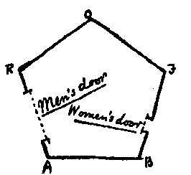
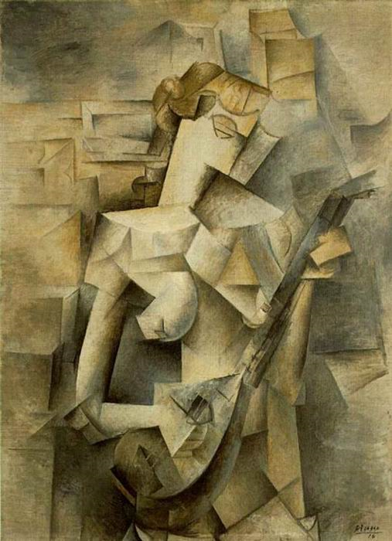
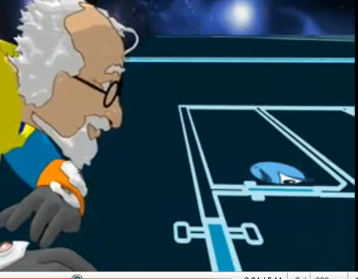
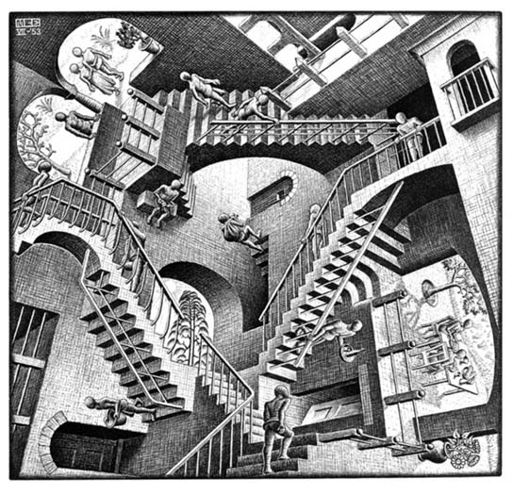
Exploring Dimensionality in Art
Cubism for 4d
Flatland for 2d
30 meters high
Quantum Cloud
Escher: non-locality

Slide 23
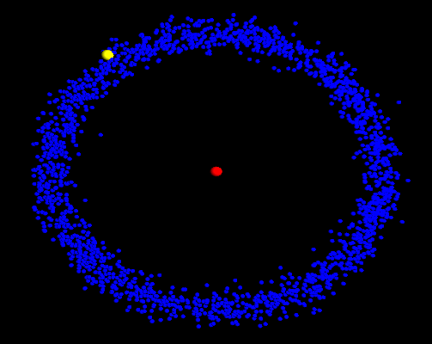
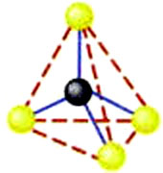
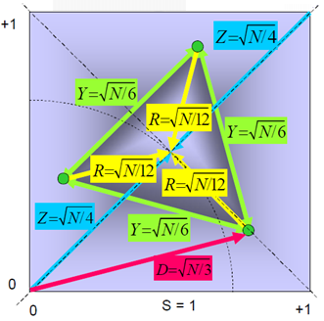
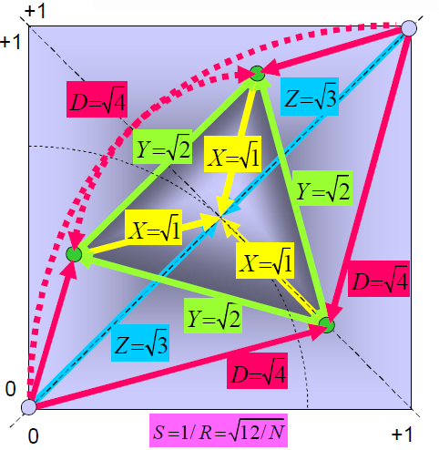
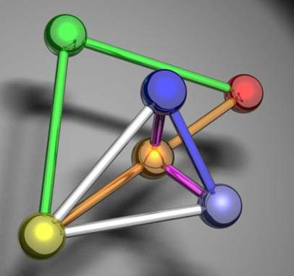
Visualizing High Dimensions
Show Animation
Show 4 dimensional Tetrahedron
correlithms

Slide 24
Temporal Topics
“Time is what prevents everything from happening at once”. John Wheeler
The Now (how big is your now?)
State change as proto-time even in spiritual world
Sequential vs. Concurrency
Causality vs. entanglement vs. synchronicity
Simultaneous and Parallelism
Time line and Panoramic Time
Time dilation and Time smearing
Precognition and 10,000 pictures
Memory and remembering the past/future
Time disassociation and NDE Tunnel
Survival and reincarnation
Eternity is who we are

Slide 25
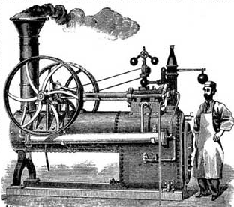
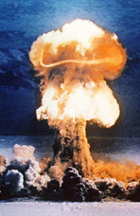
Classical Energy Topics
Energy defined by classical physics metrics
Conservation and consistency laws
2nd law and closed systems
Order, Entropy and negative entropy
Gravitational and bending space time
Observer Frames in Relativity
Classical vs. Quantum Fields
Probability and equivalent energy
Subtle energy is not classical energy
God is like a powerful computer not a bomb/engine

Slide 26
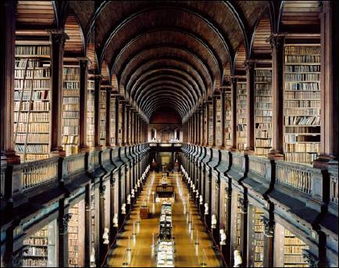
Information/Computing Topics
Information vs. communications channel
Information perfectly in right “place” and right “form”
Distinctions (bits, qubits, ebits)
Relativity always leads to slower computing
Quantum Computing is faster computing
Reversible requires more dimensions
Representation & high dimensional spaces
Memory vs. time addressing
Beliefs as structured state spaces
Thoughts are both things and actions
Asking and quantum oracle
Akashic records as quantum state spaces
Akashic records

Slide 27
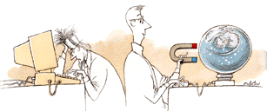
Limits and Classical Physics
Speed of Light
Uncertainty
Observability
Determinism
Density
Black holes
Relativity and Gravity
Consistency and Conservation
Undecidable and NP completeness
Locality based on number of dimensions
Dimensional projection/embedding
Observer Frame(s) for computation/awareness

Slide 28
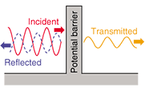
What is Vibration
Frequency vs. vibration
Light (E/M Wave)
Sound (Music, Applause)
Gravity
Succussion
Probability Amplitude
Thoughts/Rotes

Slide 29
What are Thoughts
Thoughts are both affect/effect but are not things
Are both/neither states/actions
Related to structure/topology (Anu and Rotes)
Thought bubble as quantum field
Spreads outside physical body
Awareness, attention, intention
Knowing, understanding, meaning
Memory forms emotional state dependent locality
Remember/access thoughts from anywhen

Slide 30
What is Meaning
Human meaning inside mind but project “out there”
Meaning are locations in hyperspace (focus levels)
Content addressable memories
Common sense local relationships
Understanding
Knowing
Meaning
Abstraction and Archetypes
Akashic records
Telepathy based on some universal meaning
Animal/plant/nature communication
Unconscious optimization and Gestalt answers

Slide 31
Meta Physics Ideas in Media
The force (Star wars)
Our experience is a simulation (The Matrix)
There is no spoon (The Matrix)
Law of Attraction (The Secret)
Imprinting of thoughts (What The Bleep)
Gaia in Nature (Avatar)
Intelligence is out there (ET, Strange Encounter)

Slide 32
Equations for Law of Attraction?
Semantic/meaning space of attraction
Inclusion based universe (source strands)
Emotional state based ladder
Contrast is actualization of all probabilities
The gap is pinching off energy flow
Leading edge of Source
Vibrational escrow
Vortex for emotion/thought
Expect cooperative components
Abraham is “We” or multi-being

Slide 33
What does this model mean?
Understanding of who we are:
Spiritual Beings with Oneness (more than Connectedness)
Living with no space and no time – separation is the illusion
Higher self, spiritual principles and spiritual universes
Understanding of our purpose:
Thoughts, Meaning only exists at quantum mind level
Brain/Mind connection to reality and thoughts affect everything
Law of Attraction, meaning, semantic spaces
Telepathy, language learning, metaphysics, protophysics
Arbitrary Complexity Increase
Infinite Intelligence, super mind, True intelligence
Kundalini awakening and ascension decisions
Understanding of how to apply to daily life:
Expectations for Daily Life
Living things are special and aware
Expect Miracles and Metaphysics
Energy Medicine, Healing, Life Force
Quantum Cloud and gray hole, aka chords
Intentional connections and connectedness

Slide 34
World View and Expectations
More than connected, we are all one
Higher sensitivity to all things (chose positive emotions)
Be integrated & more light like (fill in the dark places)
Thought is the ultimate information technology
Intimacy, Appreciation, Joy, Love, Safety
Inspiration, Knowing
Perfection, Divinity, Charmed, Order, Beauty
Radiance, Fairy Dust, Halos, Radiant
Abundance at all levels, health, thought, emotional
Expect and Attract Miracles
Everything is intelligent by telepathy and channeling
Divine cooperation
Higher intelligence(s) as other parts of you

Slide 35
Emotional States
Choose your emotional state:
Beyond physical – state space
Emotional scale and energy flow
Negative emotions and stuck/no energy (NLP)
Emotion dependent memory
Forgiveness (of part of yourself)
Peace, laughter, appreciation, joy, love, …
Intimacy, excitement, chills, goose bumps, …
Beauty, Ecstasy, Blistify, …
Infinite scale of emotional plateaus for joy etc.
Amplify the positive emotional states

Slide 36
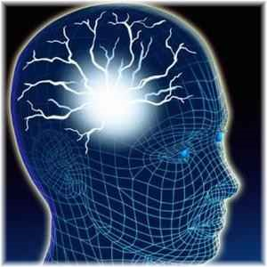
Reaching Infinite Intelligence
Real intelligence
Complexity increase
Grounding and balancing
Integration, alignment
Ultimate concurrent observer
Intuition, inspiration,
Synchronicity, entanglement
Perfect gestalt decisions
Manifestation, Co-creation
Ascension access to hyperspace

Slide 37
Quantum & Meta Physics Summary
We are spiritual beings with a physical body
We are God Stuff that is unaware of all source
Quantum mind (algorithmic speedup)
Complexity increasing due to more dimensions
Parallel computing loses sequential nature
No speed limits since no time & no space
Information is always in right place
Information is always in right form
Awareness can observe “anything”
Thoughts can affect “anything”
Ascension as increases in complexity
Perhaps technology of angels and aliens

Slide 38
Questions and Answers
End of Presentation

Slide 39
Spiritual Principles & Laws
Everything is a small piece of god
Physical world is illusion
Be like the light
Breath is life
Do unto others
Kundalini, Ascension
Energy flows where Attention goes
Not forgiving hurts you more than the other
Humor is an advanced state of being
Others? …

Slide 40
Oneness vs. Connection
Oneness means no separation (no space)
Oneness means more than connection
Individuality is an illusion
Separateness is an illusion
Connected over space
Connected over time
Oneness dimensionality doesn’t fit well in 4D

Slide 41
Connections with Others
Light
Sound (tone, etc)
Touch
Intention, Attention, and Prayer
Thoughts, Mediation and Dreaming
Overlapping Quantum Bubble
Aka chord connections
NLP change work creates non-local effects

Slide 42
Daily Dose of Source
All Life as pieces of source
Breath and Water
Intention and Attention
More Awareness
Expansion and Ascension
Inspiration, knowing, understanding, meaning
Appreciation, Joy, Intimacy, Flirting, humor, …
Lighting/releasing blocks of stagnant energy
Meditation, Prayer, Dreams
Being in the “Now” (being quantum/light like)

