Slide 1
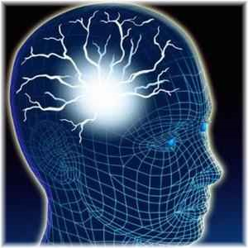
Quantum Thoughts
Presented on Tues Mar 9, 2010
Café Metaphysics
By Douglas Matzke, Ph.D.
doug@QuantumDoug.com
http://www.QuantumDoug.com

Slide 2
Abstract
This presentation will focus on what thoughts are and how they are represented as quantum vibrations. This includes such topics as brain-mind connection, law of attraction, meaning and semantics spaces. Also will explore more in depth, how a quantum thought model is different than a classical mind, especially related to metaphysics topics. Quantum vibrations essentially form a high dimensional space that is beyond a classical space time. Since none of the brain scientists can measure these quantum vibrations the spirit running the brain is not "believed" by classical neurologists. This quantum space has all the properties to support properties of mind, including storage of memories, universal computing, quantum probabilities, common sense representation, abstraction without hierarchy, law of attraction, non-local interaction in 3-space, precognitive and non-local time behaviors. Many metaphysical examples will be used to illustrate this quantum mind model, including subtle energy, remote viewing, NDE tunnels, PK/REG etc. We’ll discuss any metaphysics questions/experiences for which you've always wanted to get a better understanding!

Slide 3
Biography
Doug Matzke has a Ph.D. in quantum computing, has studied NLP for the last 5 years and has studied metaphysics topics for over 30 years. Doug creates an interesting synthesis of computation models of consciousness and spiritual ideas by using quantum science based arguments as a bridge to spirited science conclusions. He is an enthusiastic and thought provoking speaker.

Slide 4
Outline
Quantum Thoughts
Criteria for Quantum Mind/Thoughts Model
Quantum Thought Models
Classical Models
Quantum Models
What are Thoughts
Representation of Thoughts
Structure of Thoughts
Granularity of Thoughts
Thoughts and Spacetime
Where are Thoughts
When are Thoughts
Thoughts and Meaning
Thoughts and Law of Attraction
Supermind and the Divine Intelligence
The Awakening Process
Questions and Discussion

Slide 5
Criteria for Quantum Thought Model
Classical Computational Criteria
Logic, memory, math, algorithms, planning,
Abstraction, symbols, decisions, reasoning, talking,
Learning, language, understanding speech, meaning,
Brain interaction, movements, anchoring, genius,
Hypnosis, Intuition, inspiration, dreams, meditation,
Metaphysical Criteria
Remote Viewing, OBE, NDE, Clairvoyance, Telepathy
Emotions, unconscious, supermind, Precognition, PK,
Void, Nirvana, Manifestation, God consciousness,

Slide 6
Limits & Classical Mind Model
Speed of Light
Uncertainty
Observability
Determinism
Density
Black holes
Relativity and Gravity
Consistency and Conservation
Undecidable and NP completeness
Locality based on number of dimensions
Dimensional projection/embedding
Observer Frame(s) as computation perspective

Slide 7
Information is Physical
Black Hole event horizon (inside is a singularity with no space nor time)
Quantum Information is consistent with Black Hole Mechanics
Bits as entropy (Planck's areas on surface)
M➔E➔Info
Wheeler’s “It from Bit”

Slide 8
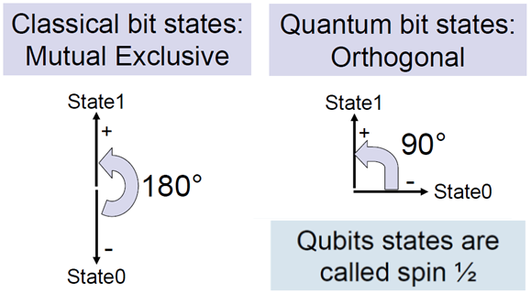
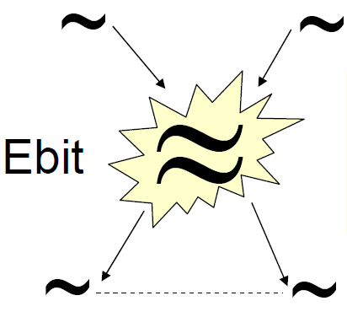
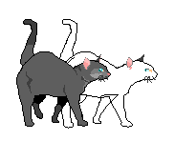
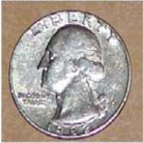
Key Quantum Properties
Classical
Quantum
Bits
QuBits
eBits
Orthogonal states: Superposition
Multiple qubits: Entanglement
Separated but Oneness States

Slide 9
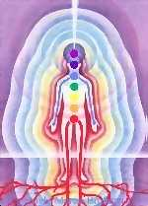
Quantum Mind Model
Thoughts are made of the strands of source
State space is outside of 4D spacetime
Very high dimensional state space
Randomness is key resource
Quantum style orthogonal states
Probabilistic state combination
CDMA style computational framework
Dimensional increase due to superposition/entanglement
Semantic relations exist & can be constructed
Brain/mind mapping using phase invariance (patent)

Slide 10
What are Thoughts
Thoughts are quantum Things! (not classical things)
Thoughts are both affect/effect
Are both/neither states/actions
Related to structure/topology (Anu and Rotes)
Thought bubble as quantum field
Spreads outside physical body
Awareness, attention, intention
Knowing, understanding, meaning
Memory forms emotional state dependent locality
Remember/access thoughts from anywhen

Slide 11
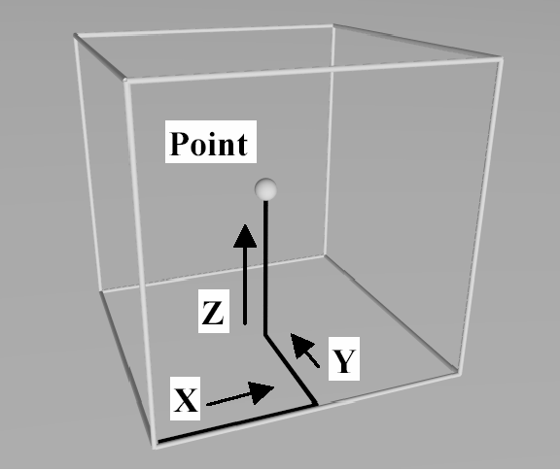
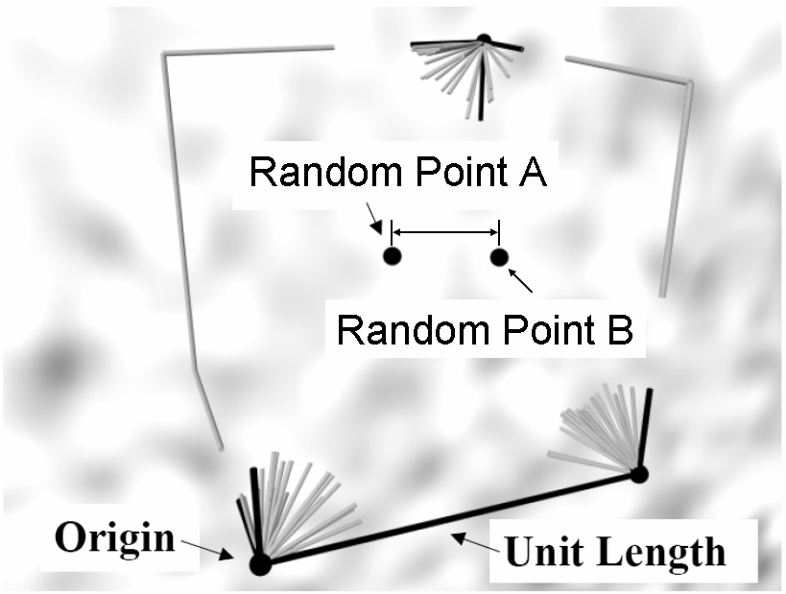
Thoughts in Quantum State Space
Thoughts formed by set of coefficients for Dimensional strands
Thought Point A
Thought Point B
Corner?
inclusion box
Inclusion based universe depends on vibrational/dimensional strands

Slide 12
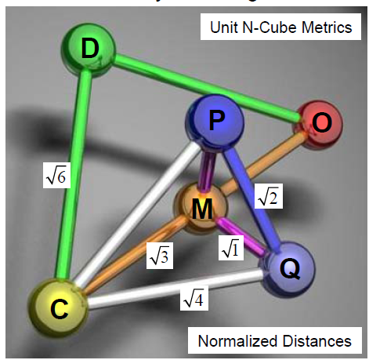
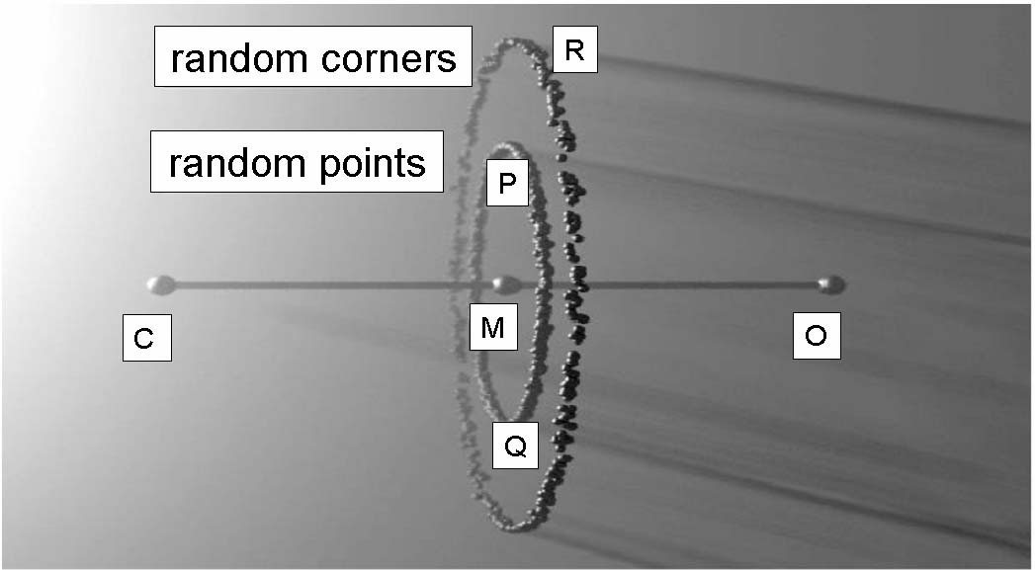
Representation of Thoughts
Random Points: correlithms

Slide 13
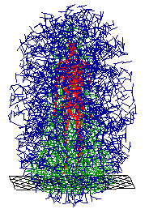
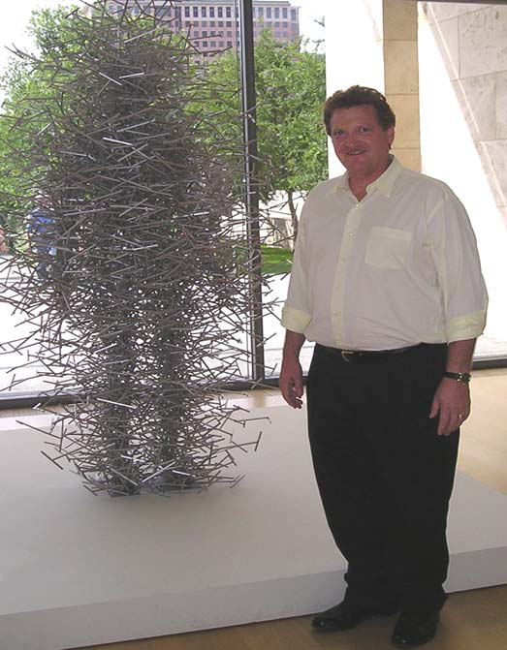
Structure of Thoughts
Non-classical Quantum Field
Quantum Cloud: Representation of high dimensions projected into 3 dimensions

Slide 14
Thoughts and Spacetime
Your choice of model understanding: (massless)
Point/address in set of dimensions: easy to see
Include collections of dimensions: allows void
No distance metrics
Coefficient/address is not classical distance
Semantics relationships are metrics of distinction
Primitive change without time
Changes of state without any universal clock
State changes represents complexity increase
Related metrics (no velocity, energy, mass, etc)
Computing without energy (all infor in right location and form).
Ordering increases complexity (No entropy or negative entropy)

Slide 15
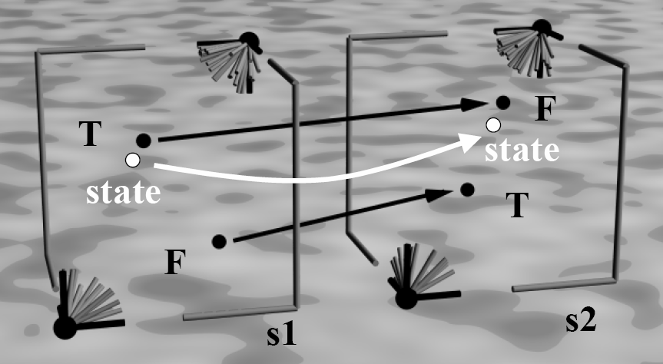
Where are Thoughts
Locations in Quantum State space: Where am I?
Aka Chords
S2A
S1A
thought
telepathy
S2B
S1B
I am 2
I am 1

Slide 16
Spatial & Dimensional Topics
Many dimensions represented by lotus flowers
High dimensional vs. holographic
Topology/Relationships/Connection
Tetrahedron shapes
Structure and Forms
Kinetic sculpture for thought
Observer frames
Non-locality means dimensions
Smarter if more dimensions
Rotes as mind “internet” packets

Slide 17
Oneness vs. Connection
Oneness means no separation (no space)
Oneness means more than connection
Individuality is an illusion
Separateness is an illusion
Connected over space
Connected over time
Oneness dimensionality doesn’t fit well in 4D

Slide 18
When are Thoughts
“Time is what prevents everything from happening at once”. John Wheeler
The Now (how big is your now?)
State change as proto-time even in spiritual world
Sequential vs. Concurrency
Causality vs. entanglement vs. synchronicity
Simultaneous and Parallelism
Time line and Panoramic Time
Time dilation and Time smearing
Precognition and 10,000 pictures
Memory and remembering the past/future
Time disassociation and NDE Tunnel
Survival and reincarnation
I am Eternity

Slide 19
Thoughts and Meaning
Human meaning inside mind but project “out there”
Meaning are locations in hyperspace (focus levels)
Content addressable memories
Common sense local relationships
Understanding
Knowing
Meaning
Abstraction and Archetypes
Akashic records
Telepathy based on some universal meaning
Animal/plant/nature communication
Unconscious optimization and Gestalt answers

Slide 20
Equations for Law of Attraction?
Semantic/meaning space of attraction
Inclusion based universe (source strands)
Emotional state based ladder
Contrast is actualization of all probabilities
The gap is pinching off energy flow
Leading edge of Source
Vibrational escrow
Vortex for emotion/thoughts
Expect cooperative components
Abraham is “We” or multi-being

Slide 21
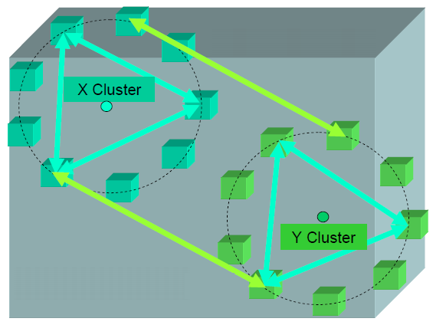
Thoughts and Vortexes of Attraction
Like thoughts are semantically near each other in localized clusters of thoughts

Slide 22
Supermind & Divine Intelligence
Real intelligence
Complexity increase
Grounding and balancing
Integration, alignment
Ultimate concurrent observer
Intuition, inspiration,
Synchronicity, entanglement
Perfect gestalt decisions
Manifestation, Co-creation
Ascension access to hyperspace

Slide 23
Awakening the Supermind
Become more like the light
No Mass, no space, no time, connection
Become more quantum and less classical
Increased dimensions and parallelism
Increased complexity thru meditation
More integration by being not doing (boredom)
Increased direct inner awareness
Change in observer away from the brain

Slide 24
Questions and Discussion
End of Presentation

