Slide 1
Update on Physical Scalability Sabotaging Performance Gains!
Dallas IEEE Computer Society Meeting Friday Jan 21, 2011
Douglas J. Matzke, Ph.D.
IEEE Senior Member
matzke@IEEE.org

Slide 2
Abstract
In September 1997, Dr. Matzke wrote the lead off paper entitled "Will Physical Scalability Sabotage Performance Gains?" for the special issue of Computer Magazine on "Billion Transistor Computer". This paper is now required reading for most computer architecture courses in the world and cited by 257 other papers. The prediction in that paper was architectures would become more fine grain due to wire scaling and most likely the billion transistor computer would be a multiple CPU machine. This paper will give an update on this prediction and talk about other trends in the architecture and device arena, including multi core cpus, hybrid core machines, Memristors and quantum computing trends.

Slide 3
Introduction and Outline
Topics in Presentation
Review of Wire Scaling Prediction
Billion Transistor computers
Current Multi-core processors – Core Wars
Process Trends and Intel roadmap
Limits of semiconductor/computer scaling
Design Trends
Memristor Fundamentals
Scaling predictions
Summary
Notes:
Unfortunately, limits to the design and construction of smaller computers will soon be reaching a critical stage because molecular and other physical limits will most likely require alternatives to deterministic classical computers. This change may require a big infrastructure and paradigm shift, as is the case with probabilistic based quantum computers. This talk discusses the technical and business ideas related to this topic.

Slide 4
Wire Scaling Prediction 1997
tgate = twire ~ R*C
Signal Drive Distance/region
tclock ~ 12 gates
Synchronizing Clock Buffer
…
Assumption:
25 simple gate delays per clock or 12 drive distance

Slide 5
Non-scaling Drive Distance
Node | 0.6 um | 0.06 um | ratio
Die length | 16 mm | 32 mm | 2 X
Gates on Die | 1 million | 400 million | 400 X
Clock Frequency | 166 MHz | 2.5 GHz | 15 X
tgate | 250 ps | 15.6 ps | 16 X
dwire locality(raw) | 5 mm | 0.03125 mm | 1/160 X
dwire locality(improv) | 5 mm | 0.125 mm | 1/40 X
dclock locality | Die if >.18 µm | 1.5 mm | 1/40 X
Gates in Region | 100,000 | 6,000 | 1/16 X
Assumptions over 8 process steps:
150% increase in gate speed per process step
20% wire improvement per process step
10% die size increase per process step

Slide 6
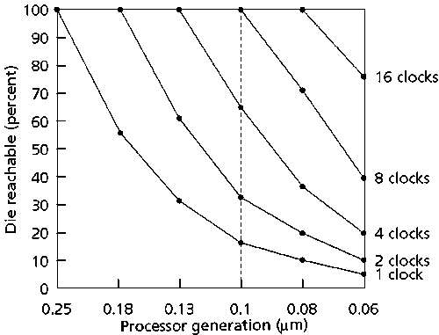
Die reachable per clock
Process nodes: .6, .35, .25, .18, .13, .1, .08 .06 µm

Slide 7
Trends Since 1997 paper
Clock speeds have maxed out ~3 GHz
Moore’s law w/high dielectric materials
Process nodes are now at 32 nm (next 22)
10 chips since 2003 w/ > 1 B transistors
Multiple CPU chips are the norm
Large fine grain GPU and FPGA chips
Power major design constraint (>200 W)

Slide 8
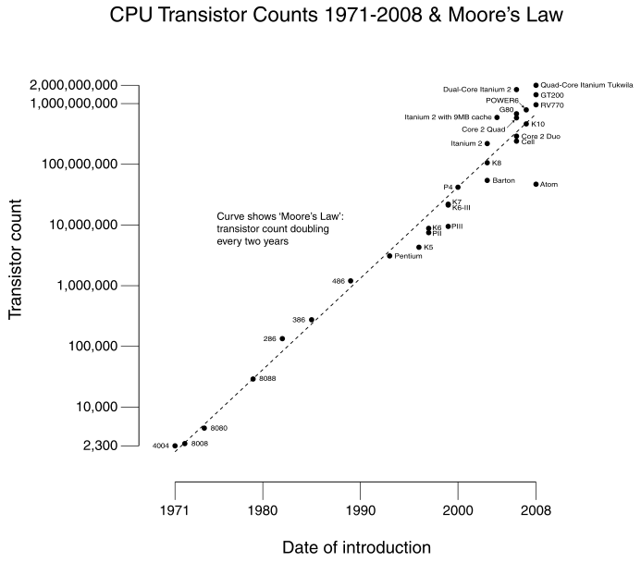
Transistor Counts 1971-2008
from wikipedia

Slide 9
Billion Transistor Chips by 2010
Product | Date | Trans | Proc | Cores | Codename | Developer
Itanium | Feb 2011 | 3.1 B | 32 nm | 8*4 | Poulson | Intel
Nvidia GTX 570 | Dec 2010 | 3 B | 40 nm | 480 | GF110 | NVIDIA/GPU
UltraSPARC T3 | Sep 2010 | 1 B | 45 nm | 16*8 | Niagara 3 | Sun/Oracle
Core i7-980X | Mar 2010 | 1.17 B | 32 nm | 6*2 | Gulftown | Intel
Intel Xeon | May 2009 | 2.3 B | 45 nm | 8*2 | Beckton | Intel
Intel Itanium | Feb 2008 | 2 B | 65 nm | 4 | Tukwila | Intel
Power7 (8-core) | Aug 2009 | 1.2 B | 45 nm | 8*4 | Power 7 | IBM
GeForce GTX 280 | Dec 2008 | 1.4 B | 65 nm | 240 | GPX 200 | NVIDIA/GPU
Itanium-2 | Oct 2005 | 1.72 B | 90 nm | 2*2 | Montecito | Intel
Stratix IV FPGA | May 2008 | 2.5 B | 40 nm | 680K | FPGA Gates | Altera
Virtex FGPA | Sep 2003 | 1 B | 70 nm | 4 PPC | FPGA w/PPC | Xilinx

Slide 10
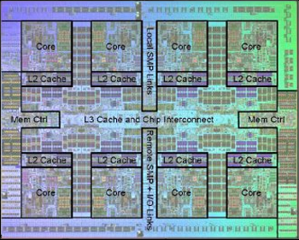
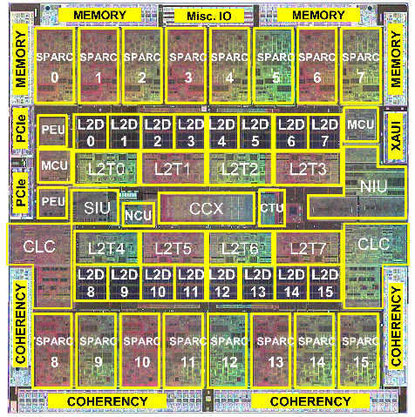
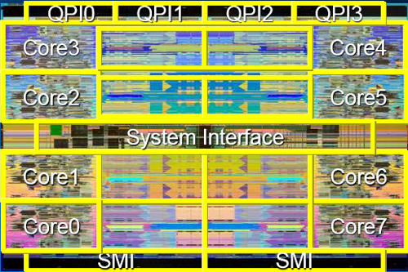
Core Wars
IBM_Power7: 8 cores
Sun Niagara 3: 16 Cores
Intel Xeon “Beckton”: 8 Cores

Slide 11
ITRS: International Technology Roadmap for Semiconductors
15 year forecast from 2003 ITRS - International Technology Roadmap for Semiconductors at: http://www.itrs.net/
These sizes are close to physical limits and technological limits.

Slide 12
Updated ITRS Forecast
15 year forecast from 2009 ITRS - International Technology Roadmap for Semiconductors-updated: http://www.itrs.net/

Slide 13
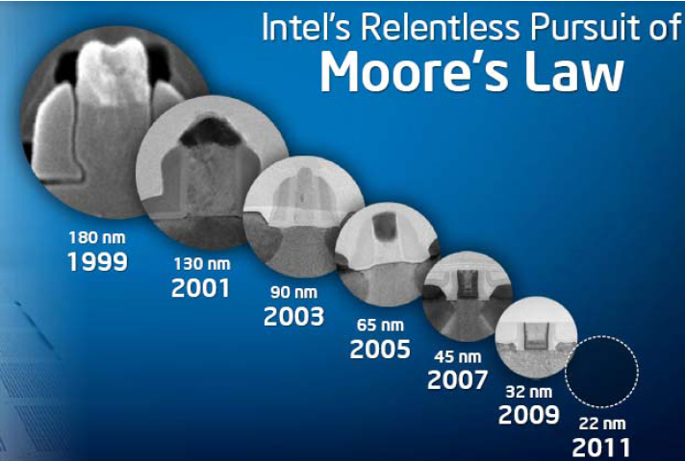
Intel’s Process Roadmap
Source: Paul Otellini, Intel CEO, “Building a Continuum of Computing”, Opening Keynote, Intel Developer Forum 2009, San Francisco, Sep 22 – 24, 2009
See HANS STORK IEEE NanoTech 2010 paper

Slide 14
Computer Scaling Limits
Physical Limits
Power density/Dissipation: max is 100 W/cm²
Thermal/noise: E/f = 100h
Molecular/atomic/charge discreteness limits
Quantum: tunneling & Heisenberg uncertainty
Technology Limits
Gate Length: min > 8 nm (with new materials)
Lithography Limits: wavelength of visible light
Power dissipation (<100 watts) and Temperature
Wire Scaling: multicpu chips at ~ billion transistors
Materials for dielectrics etc

Slide 15
2010 Design Trends
Multicpu Chips will continue
Manage power & no more clock increases
Requires innovation in parallel computing
Designs may top at < 100 cpus
CPUs and GPUS integrated (Sandy Bridge at Intel)
Higher density/lower power solutions
DSP/CPUs heterogeneous systems for portable systems
CPU/FPGA systems (Convey Computers, IBM)
New memory/logic devices (spintronics)
Memristor based systems (HP, Numenta)
Quantum Computing is nitch market

Slide 16
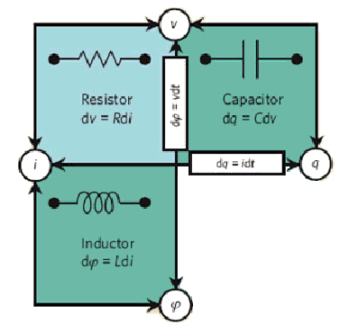
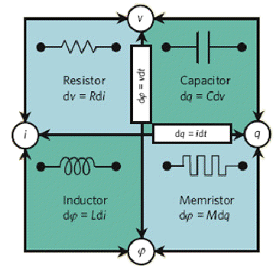
Memristor Fundamentals
Three original 2-terminal circuit elements (based on current, voltage, charge, and magnetic flux relationships)
In 1971, Leon Chua, an electrical engineer professor at UC Berkley, arranged the linear relationships between each of the four basic variables describing the above circuit relationships.
four final 2-terminal circuit elements

Slide 17
Scaling Predictions
Semiconductors will stop scaling in <10 yrs
Nanocomputers won’t stop this; only delay it
Breakthroughs required or industry stagnates
College students consider non-semiconductor careers
High dimensional Research in other areas:
Deep meaning and automatic learning
Programming probabilistic parallel computers
Noise as valued resource instead of unwanted
Higher dimensional computing
Investigate non-local computing
Biological inspired computing – Quantum Brain?

Slide 18
Summary
Predictions in ‘97 came true as expected
Scaling wall is now visible to industry
Heat limits my stop multiprocessor count
Materials innovation allows more of Moore
New devices may help scaling (more than Moore)
Fab Costs may slow before physical limits
Must think outside 3d box (quantum?)
Watch for unexpected aspects of qunoise
Tablet/phone computing changes markets
Clouding computing virtualization trends
Questions and Discussions

