Slide 1
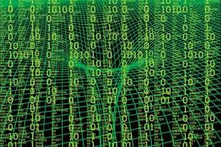
The Higgs and the Pervasive Nature of Quantum Entanglement
Dallas IEEE Computer Society
Mar 8, 2013
UT Dallas Campus
Doug Matzke, PhD
matzke@IEEE.org
www.QuantumDoug.com
www.TauQuernions.org

Slide 2
Abstract
Are you curious about the Higgs boson that captured everyone's attention last year? This talk discusses a new model of the Higgs Boson based entirely on quantum entanglement's Bell and Magic states (see www.TauQuernions.org). I will introduce and discuss:
How entanglement originates from quantum computing (qubits are NOT part of the Standard Model),
The nature of quantum non-locality for ebits (many things acting non-locally as one),
Why entanglement is irreversible (due to information erasure),
How entanglement becomes the basis for 3+1d space itself (TauQuernions are entangled Quaternions),
How the entangled TauQuernions form the Higgs.
Additionally, we predict "dark bosons" (3D rotations of TauQuernions ) that combine to form 4 variants of dark matter. We also predict two Higgs decay forms using our novel state classification system.
During the talk, I will demonstrate the custom Python-based symbolic math tools we developed. These tools allowed an information-theoretic analysis over all the states of our finite and discrete algebras (Geometric Algebra), leading ultimately to a novel entropically-driven Bit Bang model of the universe.
This presentation is intended for an audience of non-technical, CS, EE and Physics personnel. So everyone curious about the informational nature of entanglement, the Higgs and dark matter is welcome. This presentation is being recorded and will be available on YouTube.

Slide 3
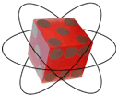
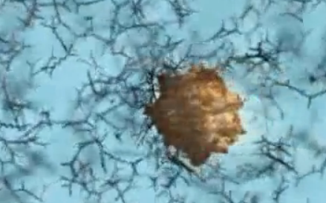
Summary of Talk
Quantum Entanglement is:
From Qubits/Ebits (not classical nor standard model)
High Dimensional for n ≥ 4
Probability amplitudes (non-local waves)
Non-local correlations (EPR/Bell’s Theorem)
Pervasive and stable due to irreversibility
Quantum Entanglement underlies:
Quantum Computing (e.g. Shor’s algorithm)
Entangled 3D+1 TauQuernion Space
Higgs Field and Higgs Boson
Dark Bosons and Dark Matter

Slide 4
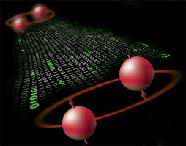
Definition of Entanglement:
Entanglement is a quantum property:
Only Quantum systems (not classical)
Non-local due to high dimensions
Einstein’s “Spooky action at a distance”
EPR and Bell/Magic states/operators are well defined
Property known as inseparable quantum states
Bell/Magic Operators are irreversible in GALG*
Multiple things (Qubits) acting as one thing (Ebit)
+
+
-
-
+
-
* Geometric Algebra

Slide 5
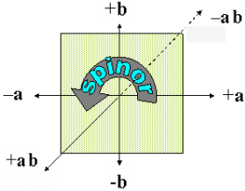
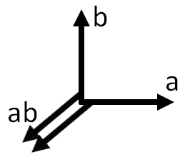
Geometric Algebra Summary
Vectors, bivector, trivectors, n-vectors, multivectors
Multivector Spaces (for G_{n} size is 3^{(2**n)})
G₀ is size 3: {0, ±1}
G₁ is size 9: {0, ±1, ±a}
G₂ is size 81: {0, ±1, ±a, ±b, ±ab}
G₃ is size 6,561: {0, ±1, ±a, ±b, ±c, ±ab, ±ac, ±bc, ±abc}
G₄ is size 43,046,721: {0, ±1, ±a, ±b, ±c, ±d, …, ±bcd, ±abcd}
Anti-commuting vector space
ab = –ba → (ab)² = abab = –1 so any bivector xy = is spinor i
Arithmetic Operators over Z₃ = {±1=T/F, 0=does not exist}
+, * (geometric ~ ), outer (a^a=0,a^b=ab), inner (a•a=1,a•b=0)
Co-occurrence (+) & co-exclusion: (a-b)+(-a+b)=0 implies ab
Row vector truth table duality (e.g. ±(1+a)(1+b)=[0 0 0 ±]).

Slide 6
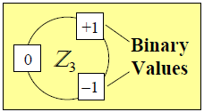
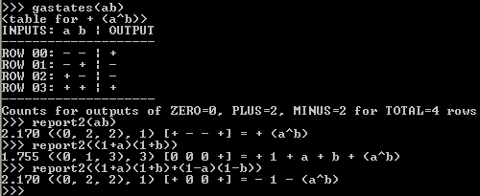
Geometric Algebra Tools
Custom symbolic math tools in Python (operator overloading):
C:\python -i qubits.py
>>> a+a ← Mod3 addition for change based logic (xor)
- a
>>> b^a ← anticommutative bivectors
- (a^b)
>>> c^b^a ← anticommutative trivectors
- (a^b^c)
>>> (1+a)(1+b)(1+c) ← Smallest vector state contains all algebraic terms
+ 1 + a + b + c + (a^b) + (a^c) + (b^c) + (a^b^c) ← Row vector state equivalent [0000 000+]
>>> a0 ← Single Qubit State
+ a0
>>> A ← Classical Qubit A
+ a0 - a1
>>> Sa ← Qubit Spinor
+ (a0^a1)
>>> Sa*Sa ← so Spinor = sqrt(-1)
-1
>>> A*Sa ← Superposition
+ a0 + a1
>>> A*B ← Quantum Register (where B = + b0 - b1)
+ (a0^b0) - (a0^b1) - (a1^b0) + (a1^b1)
← Truth Table of row vector output states
← Bits, sig, vector, = expr

Slide 7
Space and Time Proto-Physics
Co-occurrence means states exist simultaneously: Space-like via + operator
Co-exclusion means a change occurred due to an operator: Time-like via * operator
“Information is Physical” by Rolf Landauer
“It from Bit” in Black Holes by John Wheeler

Slide 8
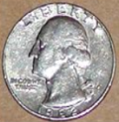
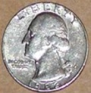
Coin Demo: Act I
Setup:
Person stands with both hands behind back
Act I part A:
Person shows hand containing a coin then hides it again
Act I part B:
Person again shows a coin (indistinguishable from 1st)
Act I part C:
Person asks: “How many coins do I have?”
Represents one bit: either has 1 coin or has >1 coin

Slide 9
Coin Demo (continued)
Act II:
Person holds out hand showing two identical coins
We receive one bit since ambiguity is resolved!
Act III:
Asks: “Where did the bit of information come from?”
Answer: Simultaneous presence of the 2 coins!
Non-Shannon space-like information derives from simultaneity!

Slide 10
Complexity Signatures
Multivector = Equivalent Row Vector
Multivector = Equivalent Row Vector
abc = [– + + – + – – +] | abc = [– + + – + – – +]
+1 = [+ + + + + + + +]_ | –1 = [– – – – – – – –]_
abc+1 = [0 – – 0 – 0 0 –] | abc–1 = [+ 0 0 + 0 + + 0]
→(0, 4, 4)
→(0, 4, 4)
Given any multivector in 𝔾_{n} and its corresponding row vector, compute a tuple (#0s, #+s, #–s) based on the counts of elements in the row vector. The sorted tuple, represents the state complexity of the multivector.
Space | Signature | Count | Description | Structural complexity | Bits
n=0 | (0, 0, 1) | 3 | Scalars {0, ±1} → [±] | 0 | 0
n=1 all=9 | (0, 0, 2) | 3 | Scalars {0, ±1} → [±±] | 0 | 1.58
 | (0, 1, 1) | 6 | Vectors ±x & ±1±x → [±∓] | 1 | 0.58
n=2 all=81 | ((0, 0, 4), 0) | 3 | Scalars {0, ±1} → [±±±±] | 0 | 4.75
 | ((0, 1, 3), 3) | 24 | Row Decode ±(1±x)(1±y) | 3 | 1.75
 | ((0, 2, 2), 1) | 18 | Singletons ±x and ±xy | 1 | 2.17
 | ((1, 1, 2), 2) | 36 | ±x ± y and ±1 ± x ± y | 2 | 1.17
n=2 all=81 | (0, 0, 4) | 3 | Scalars {0, ±1} → [±±±±] | 0 | 4.75
 | (0, 1, 3) | 24 | Row Decode ±(1±x)(1±y) | 3 | 1.75
 | (0, 2, 2) | 18 | Singletons ±x and ±xy | 1 | 2.17
 | (1, 1, 2) | 36 | ±x ± y and ±1 ± x ± y | 2 | 1.17
Add structural complexity (singleton count) to the signature to support larger spaces.
* Coin Demo 1.000 bit = 2.17 – 1.17

Slide 11
More Signatures in 𝔾₃ & 𝔾₄
Space | Signature | Count | Description | Bits
n=3 6,561 | ((0, 0, 8), 0) | 3 | Scalars {0, ±1} → [±±±± ±±±±] | 11.1
 | ((0, 1, 7), 7) | 48 | Row Decode ±(1±w)(1±x)(1±y) →[±000 0000] | 7.09
 | ((0, 2, 6), 3) | 168 | ±x ±y ±xy | 5.29
 | ((0, 3, 5), 6) | 336 | ±x ±y ±xy ±xz ±yz ±xyz | 4.29
 | ((0, 4, 4), 1) | 42 | Singletons ±x, ±xy and ±xyz | 7.29
 | ((0, 4, 4), 4) | 168 | Some variations of ±y ±z ±xy ±xz | 5.29
 | ((2, 2, 4), 2) | 252 | Co-occurrence ±x ±y is a qubit | 4.70
 | ((2, 3, 3), 3) | 672 | Co-occurrence ±x ±y ±z is a photon | 3.29
 | <not shown 5 signatures of 14 total bins>
 | ((1, 3, 4), 4) | 1,344 | Smallest information content in 𝔾₃(e.g. ±a±b±c±xy) | 2.29
n=4 3^{(2**n)} | ((0, 0, 16), 0) | 3 | Scalars {0, ±1} → [±±±± ±±±± ±±±± ±±±±] | 23.8
 | ((0, 1, 15), 15) | 96 | Row Decode ±(1±w)(1±x)(1±y)(1±z) | 18.8
 | ((0, 8, 8), 1) | 90 | Singletons ±x, ±xy, ±xyz and ±wxyz | 18.9
 | ((4, 4, 8), 2) | 1,260 | Co-occurrence ±x ±y, ±wx ±yz , ±w ±xyz | 15.1
 | <not shown 81 signatures of 86 total bins>
 | ((4, 5, 7), 11) | 5,040K | Smallest information content in 𝔾₄ (11 singletons) | 3.09

Slide 12
Qubit: a bit in Superposition
Classical bit states: Mutually Exclusive
Quantum bit states: Orthogonal
State1
State1
spin ½
+
+
90°
+
-
180°
-
State0
-
State0

Slide 13
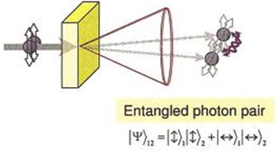
Ebits: Entangled Qubits
+
-
Bell/Magic Operators (in 𝔾₄):
Bell operator = S_{A} + S_{B} = a0 a1 + b0 b1
Magic operator = S_{A} – S_{B} = a0 a1 – b0 b1
Bell/Magic States B_{i} and M_{i} form rings:
Cannot factor: – a0 b0 + a1 b1 (Inseparable)
Bell and Magic operators are irreversible in 𝔾₄ (different from Hilbert spaces)
See proof that 1/(S_{A} ± S_{B}) does not exist for Bell (or Magic) operators
Multiplicative Cancellation – Information erasure is irreversible
Qubits A₀ B₀ = + a0 b0 – a0 b1 – a1 b0 + a1 b1 = B₃ + M₃
0 = Bell * Magic = Bell * M_{j} = Magic * B_{i} = B_{i} * M_{j}
B_{(i+1)mod4} = B_{i} (S_{A} + S_{B})
B₀ = A₀ B₀ Bell = – S₀₀ + S₁₁ = Φ⁺
B₁ = B₀ Bell = + S₀₁ + S₁₀ = Ψ⁺
B₂ = B₁ Bell = + S₀₀ – S₁₁ = Φ–
B₃ = B₂ Bell = – S₀₁ – S₁₀ = Ψ–
B₀ = B₃ Bell = – S₀₀ + S₁₁ = Φ⁺
M_{(i+1)mod4} = M_{i} (S_{A} – S_{B})
M₀ = A₀ B₀ Magic = + S₀₁ – S₁₀
M₁ = M₀ Magic = – S₀₀ – S₁₁
M ₂ = M₁ Magic = – S₀₁ + S₁₀
M ₃ = M₂ Magic = + S₀₀ + S₁₁
M₀ = M₃ Magic = + S₀₁ – S₁₀

Slide 14
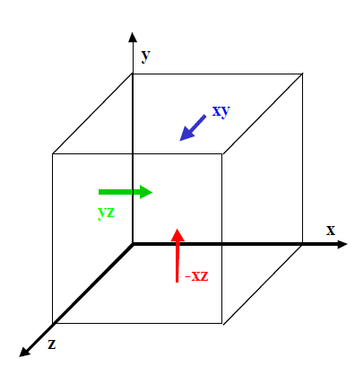
TauQuernions: Entangled Quaternions
TauQuernions (𝓣_{i}, 𝓣_{j}, 𝓣_{k} & conjugate set 𝓣_{i}’, 𝓣_{j}’, 𝓣_{k}’):
Entangled Quaternion isomorphs
𝓣_{i} = ab – cd, 𝓣_{j} = ac + bd and 𝓣_{k} = ad – bc
𝓣_{i}’= ab + cd, 𝓣_{j}’= ac – bd and 𝓣_{k}’= ad + bc
Anti-Commutative: 𝓣_{x} 𝓣_{y} = –𝓣_{x} 𝓣_{y}
𝓣_{i} 𝓣_{j} 𝓣_{k} = 1 + abcd = “–1” (sparse –1)
(“–1”)² = “+1” = –1 ±abcd (sparse +1:idempotent)
Quaternions i,j,k:
{xy, xz, yz}
* | 𝓣_{i} | 𝓣_{j} | 𝓣_{k}
𝓣_{i} | 1 + abcd | –ad + bc | ac + bd
𝓣_{j} | ad – bc | 1 + abcd | –ab + cd
𝓣_{k} | –ac – bd | ab – cd | 1 + abcd
* | 𝓣_{i} | 𝓣_{y} | 𝓣_{k}
𝓣_{i} | “–1” | –𝓣_{k} | 𝓣_{j}
𝓣_{j} | 𝓣_{k} | “–1” | –𝓣_{i}
𝓣_{k} | –𝓣_{j} | 𝓣_{i} | “–1”
𝓣_{i} | 𝓣_{j} | 𝓣_{k}
Magic | M₃ = –M₁ | M₀ = –M₂
Magic | M₃ = –M₁ | M₂ = –M₀
Magic | M₁ = –M₃ | M₀ = –M₂
Magic | M₁ = –M₃ | M₂ = –M₀
𝓣_{i}’ | 𝓣_{j}’ | 𝓣_{k}’
Bell | B₂ = –B₀ | B₁ = –B₃
Bell | B₂ = –B₀ | B₃ = –B₁
Bell | B₀ = –B₂ | B₁ = –B₃
Bell | B₀ = –B₂ | B₃ = –B₁
use –𝓣_{i} as the Higgs own
anti-particles

Slide 15
Bosons X²=0 (Nilpotents)
Find all bosons in 𝔾 using: gasolve([a,b, ...], lambda X: X*X, 0)
Space | Count | Boson Multivector | Boson Description
𝔾₀ & 𝔾₁ | Total 0 | Exclude 0 from this table | 0²=0
𝔾₂ | Total 8 |  | (qubit space)
 | 8 | ±x ±xy = ±x*(1 ± y) | Weak Force Bosons W/Z
𝔾₃ | Total 80 | *quarks are: ±x ±yz | (Standard model Space)
 | 8 | ±a ±b ±c | Photonic Boson (Qutrit)
 | 24 | ±x ±xy | Weak Force Bosons in 𝔾₃
 | 8 | ±ab ±ac ±bc | Quaternions are bosonic
 | 24 | ±x ±z ±xy ±yz | Mesons are two quarks
 | 16 | ±x ±y ±z ±xy ±xz ±yz | Strong Force (Gluons)
𝔾₄ | Total 7,280 |  | 30 Different signatures
 | 80 | ±x ±xy and ±w ±xyz | Weak and Dark Bosons
 | 528 | (ab - cd) + (ac + bd) + (ad - bc) & … | 16 Higgs Boson & others
 | … | … | 28 more signatures
𝔾₃ is equivalent to Pauli Algebra and 𝔾₄ contains Dirac Algebra. Also Parsevals Identity

Slide 16
Particles X²=1 (Unitary)
Find all Unitaries in 𝔾 using: gasolve([a,b, ...], lambda X: X*X, 1)
Space | Count | Unitary Multivector | Particle Description
𝔾₁ | Total 2 | ± a | Exclude scalar value of ±1
𝔾₂ | Total 12 |  | (qubit space)
 | 4 | ±x | Vectors are distinctions
 | 8 | ±a ±b ±ab | Neutrinos
𝔾₃ | Total 90 | *quarks are: ±x ±yz | (Standard model Space)
 | 6 | ±x | Vectors are distinctions
 | 24 | ±x ±y ±xy | Neutrinos (3x8=24)
 | 12 | ±xy ±xz | Electrons (3x4=12)
 | 48 | ±x ±y ±z ±xy ±xz | Protons (neutrons = xyz protons)
𝔾₄ | Total 12,690 |  | 17 Different signatures
 | 10 | ±x and ±wxyz | Vectors and Mass Carrier
 | … | … | 16 more signatures
For X² = X (Idempotent) and U² = 1 (Unitary) then X = –1 ± U (proof X² = (–1 ± U) ² = X)

Slide 17
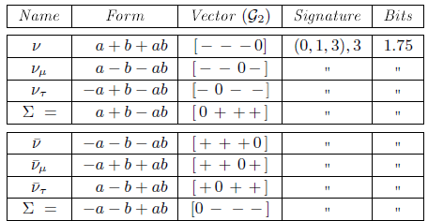
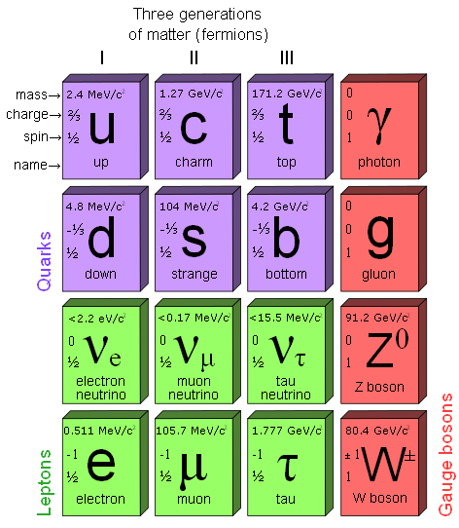
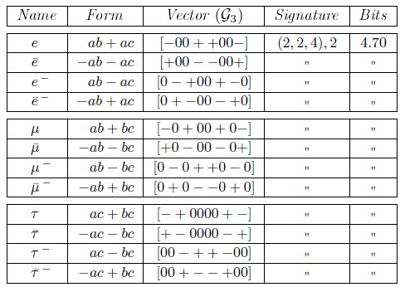
Standard Model in 𝔾₂ & 𝔾₃
Z₅

Slide 18
Higgs Bosons are Entangled
The proposed Higgs Boson in 𝔾₄:
ℋ = 𝓣_{i} + 𝓣_{j} + 𝓣_{k} (where ℋ² = 0)
Eight triples: ±𝓣_{i}±𝓣_{j}±𝓣_{k} (and 8 more for ±𝓣_{i}’±𝓣_{j}’±𝓣_{k}’)
Also various factorizations:
ℋ = (±1 ±abcd)(ab + ac + bc) Time-like mass acts on Space
ℋ = (a + b – c)d + ab + ac – bc Light and space
ℋ is its own anti-particle (when using –𝓣_{i})
The Higgs ℋ and proto-mass ℳ cover even subalgebra:
ℋ = {X = ± ab ±ac ±bc ±ad ±bd ±cd | X² = 0} (16)
For X = ℋ then X abcd = abcd X = ± X
ℳ = {X = ±ab ±ac ±bc ±ad ±bd ±cd | X² = ±abcd} (48)
For X = ℳ then only X abcd = abcd X
sig ((4, 6, 6), 6) = 32 and sig ((0, 6, 10), 6) = 16

Slide 19
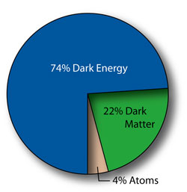
Dark Bosons are also Entangled
(wx+yz)(xyz) = (–x+wyz) and also (w+xyz)(wxy) = (wz+xy)
+
+
State Name | Entangled State | 𝓓_{B} = State * (wxy)†
Bell | + wx + yz | – y – wxz
B0 | – wy + xz | – x + wyz
B1 | + wz + xy | – w – xyz
B2 | + wy – xz | + x – wyz
B3 | – wz – xy | + w + xyz
-
-
Magic | + wx – yz | – y + wxz
M0 | + wz – xy | + w – xyz
M1 | – wy – xz | – x – wyz
M2 | – wz + xy | – w + xyz
M3 | + wy + xz | + x + wyz
Quarks: ± w ± xy
Dark bosons: ± w ± xyz
† Results are dark bosons 𝓓_{B} where (𝓓_{B})² = 0 and are entangled since 𝓓_{B} are not separable.

Slide 20
Dark Matter is Entangled
Define set 𝓓 as sum of 4 dark bosons (count 256) :
𝓓 = {(±w ±xyz) + (±x ±wyz) + (±y ±wxz) + (±z ±wxy)}
where 𝓓 is the largest odd sub-algebra of 𝔾₄ and
rotations {xyz 𝓓} = {–1 + wxyz + ℋ ⋃ ℳ}
The elements of 𝓓² form three (four) subsets:
𝓓_{q} = {𝓓 Є D| D² = xy + xz + yz} (count 128, sig ((2, 7, 7), 8), 6.87 bits)
𝓓₀ = {𝓓 Є D| D² = 0} (Bosons) (count 32, sig ((4, 4, 8), 8), 5.53 bits)
𝓓_{u} = {𝓓 Є D| D² = (w + x)(y + z) & D⁸ = 1 (2 qubits) (count 96)
𝓓_{u} with (count 80, sig ((4, 4, 8), 8), 5.53 bits)
𝓓_{u} with (count 16, sig ((1, 1, 14), 8), 15.9 bits)

Slide 21
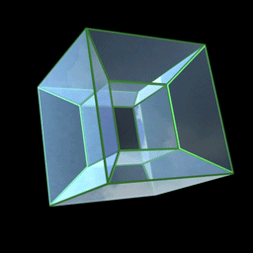
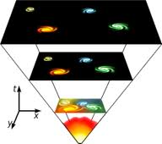
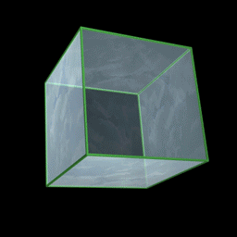
Big Bang Energy from Bit Bang?
Bit Bang information growth as source of energy:
Space-like co-occurrence of vectors (+) creates non-Shannon bits
Time-like operator (*) creates new n-vectors, increasing diversity
Space Dims
Vectors
2.17 bits
0.58 bits
Operator | Informational Effect
+ | Non-Shannon Information
* | Creates new n-vectors
G₄
G₃
18.9 bits
7.29 bits
Complxi ty
{±1 ±a ±b ±c ±d … ±abcd}
{±1 ±a ±b ±c ±ab ±ac ±bc ±abc}
G₂
G₁
{±1 ±a ±b ±ab}
{±1 ±a}
No Space
No Time
No Matter
No Energy

Slide 22
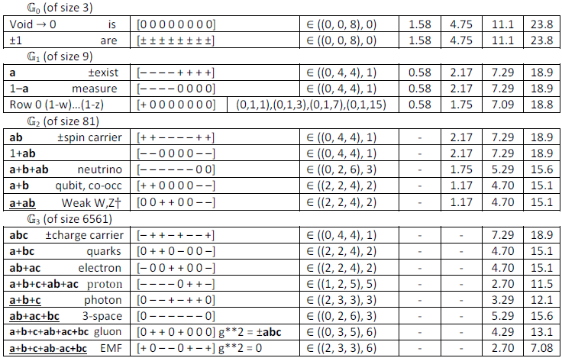
Big Bang Fueled by Bit Bang
Tentative; bosons (nilpotent)
Higher Entropy
Lower Entropy

Slide 23
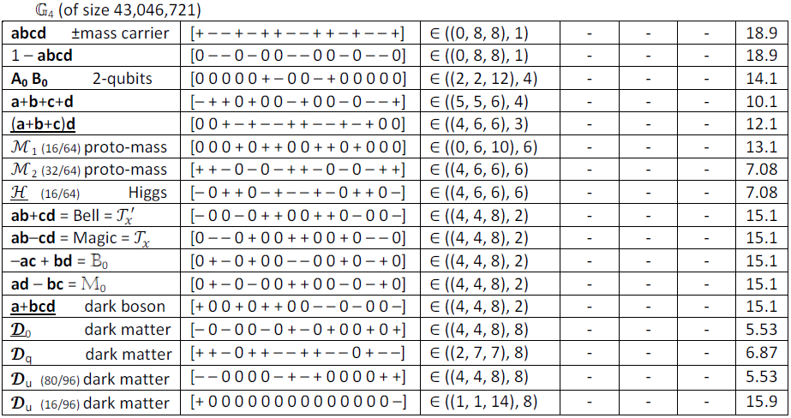
Entanglement, Mass & Higgs in 𝔾₄
*
*
*
*
*
* Higgs & dark matter states are very common; simple entangled states & others are less so

Slide 24
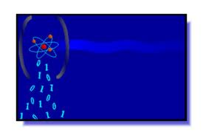
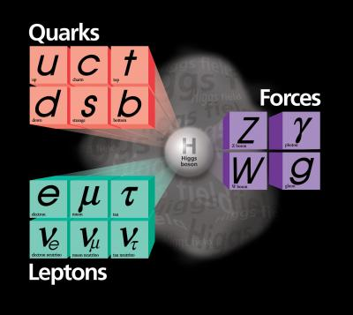
Novel Conclusions & Predictions
Geometric Algebra is useful computer science paradigm for quantum computing, and enables tool construction
Space/time proto-physics is connected to non-Shannon space-like information creation and release (Coin-Demo)
Data mining of nilpotents/idempotents/unitaries in G₁– G₃ identifies the Standard Model bosons/fermions (4 neutrinos)
Qubits (in G₂) construct ebits (in G₄) and lead to novel results about irreversibility of Bell/Magic operators/states
TauQuernions form entangled 3-space with its entangled Higgs field supporting the proposed Higgs Boson in G₄
Odd sub-algebra of rotated Higgs produces entangled Dark Bosons and 4 forms of proposed Dark Matter (some bosons)
Complexity Signatures and Bit Content in G₁– G₄ fuel information creation of Bit Bang
Particle/Antiparticle are co-exclusions (P+A=0)
Entanglement pervades Space, Higgs & Dark States
Means novel results reported in Dec 2012

