Slide 1

Discovering your Psychic superpowers
Quantum Doug Matzke
IONS DFW Meetup
Sunday Nov 2, 2014
www.quantumdoug.com
www.spiritedscience.org

Slide 2
abstract
We all know people with "gifts" and may even experience our own special abilities at times. My favorite question when talking to people about psychic experiences is to ask "What is your superpower?". Everyone has superpowers, even if their individual beliefs may hinder their development.
This talk is for you, whether you disbelieve in superpowers because "science says it impossible" or you already know one of your superpowers. We will discuss the science behind how the mind can not be chemical, electromagnetic, neurological or any other classical physics based matter/energy mechanism. The newest research consistently demonstrates the mind and thoughts are informational, non-local in space, not bound to time, vibrational, high dimensional and can directly interact with the physical world. My theory is "superpowers" are possible due to the quantum nature of minds, thoughts and subtle energy. Meaning and intention only exists in the high dimensional quantum mind, which is the mechanism behind Law of Attraction.
We will open the floor to discuss our individual superpowers and discuss the quantum mind principles supporting those abilities. I will demonstrate one of my own superpowers. You we leave this meeting with a stronger understanding and belief that we are all eternal spiritual beings with quantum minds where superpowers are natural and expected.

Slide 3
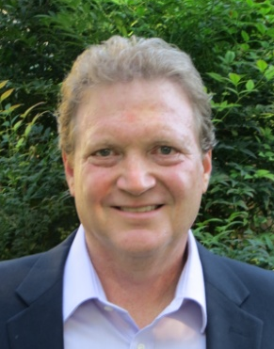
Who is Quantum Doug?
Doug Matzke has a Ph.D. in quantum computing and has worked in the computing industry for nearly 40 years. Doug continues to research topological properties of quantum spaces by using custom computer programs. Recently he mathematically proposed that the Higgs Boson and dark matter/energy are all entangled states, so are fundamentally different than the standard model.
Quantum Doug is a certified master practitioner in NeuroLinguistic Programming (NLP) and has studied metaphysics for over 40 years. He mediates daily, is trained in Reiki II plus has learned several other energy modalities. His passion is describe Quantum Mind concepts using protophysics/metaphysics explanations.

Slide 4

Outline of Talk
Group Discussion on superpowers
Seven superpower concepts
  Based on Quantum protophysics
  Examples from daily life
How to develop your superpowers
Superpower exercises
Summary and Conclusions

Slide 5
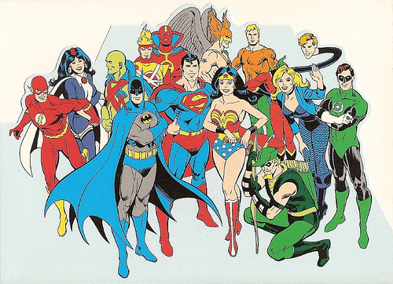
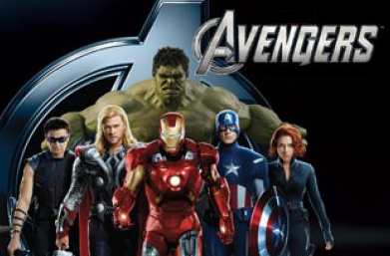
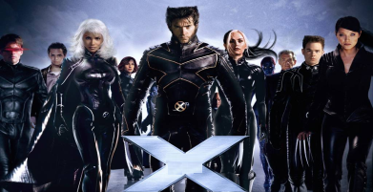


Superpower Group Discussion
Hollywood Superpowers
  Movies: The Force, X-Men & Marvel Avengers
  TV old: Heroes, Alphas, Medium
  TV new: The Listener, Scorpion
Ancient Superpowers
  Yoga Sutras and Siddhis

Slide 6


Do you know your superpower?
What if I had a

Slide 7
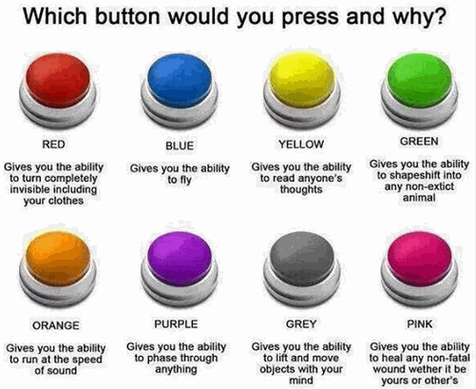
Possible Superpowers?

Slide 8

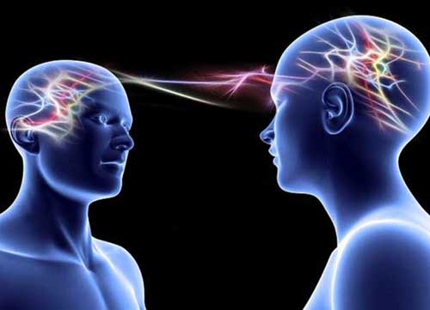
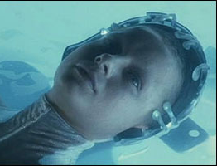

Real superpowers?
Superpowers are common
  Dreaming: fly, go thru walls
  Synchronistic events
  Direct Knowing
  Distance information
  Effecting Electronics
  Law of Attraction
  Near Death Experiences
  Out of Body Experiences
  Telepathy & others’ thoughts
  Precognition

Slide 9

Why No Superpowers?
Reasons for missing out
  Branded as weird or unscientific
  Society skepticism and trash talk
  Lack of Community support
  Opposing beliefs
  Disbeliefs and doubt
  Lack of interest
  Emotional baggage & sabotage
  Lack of focus and concentration
  Low Chi energy due to many factors

Slide 10

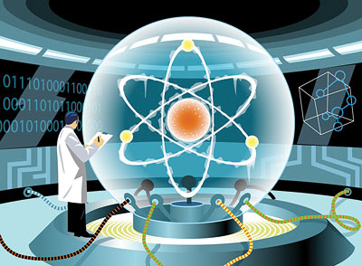
Quantum Protophysics

Slide 11
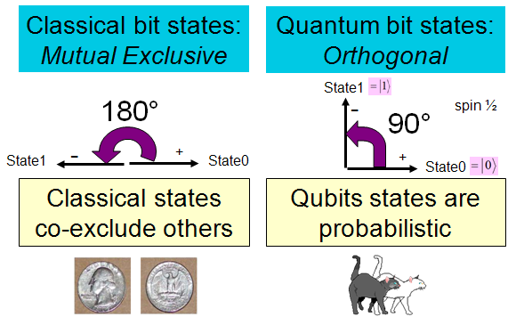
Classical Bits vs. Qubits

Slide 12
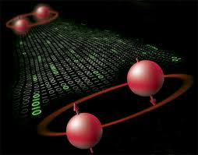
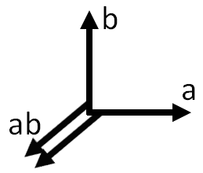
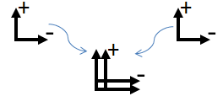
Qubits vs. Ebits
Qubit1
Qubit2
entanglement
superposition
superposition
Ebit
(4 dimensional)

Slide 13
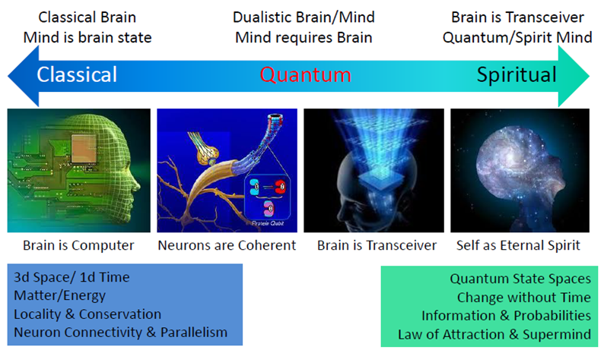
Brain/Mind/Spirit Continuum

Slide 14
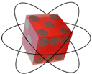
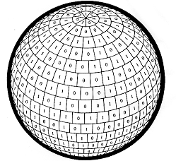
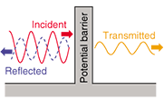
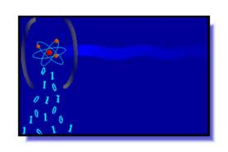
1st concept: “information is physical” and “it from bit”
Bits are physical and are primitive to physics
Each bit has an effective energy and mass
Quantum waves superpower is invisibility/tunneling
Bits superpower is indestructibility
Qubits superpower is superposition
Ebits superpower is non-locality oneness

Slide 15
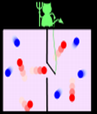
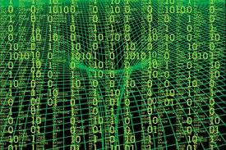
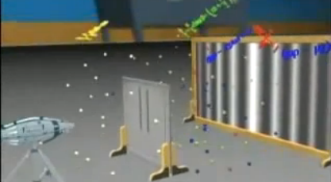
1st examples: It from Physical bits
Each bit has an effective energy and mass
Black Holes are bit buckets “filled” with bits
Particle/wave duality (twin slit experiment)
Probability amplitude waves (consistency)
Spacetime (3d+time) from quantum foam
Entangled states (quantum teleportation)
Landauer’s principle & Maxwell’s Demon

Slide 16
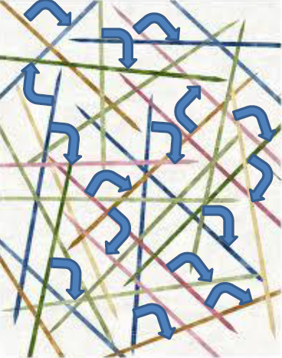
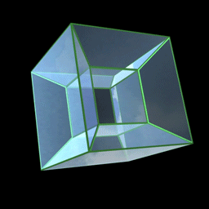
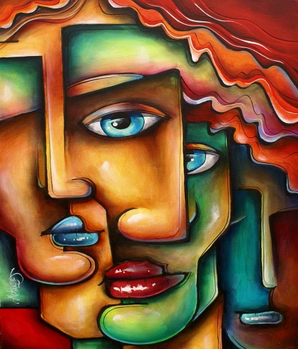
2nd concept: the universe is a very high dimensional quantum matrix
Proto-dimensions (or vibrating strings)
Bit = 1 dim, qubit = 2 dims, photon = 3 dims
Entanglement requires 4 dimensions
Orthogonality of dimensions (>>2³⁰⁰)
Higgs Boson is most likely entangled
Dark Matter/energy is most likely entangled

Slide 17
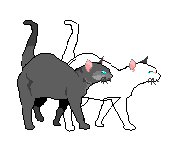
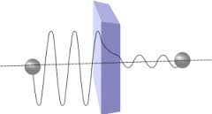
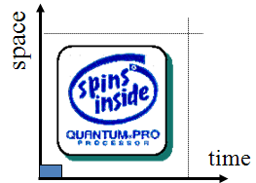
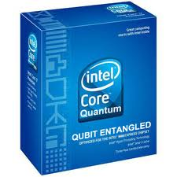
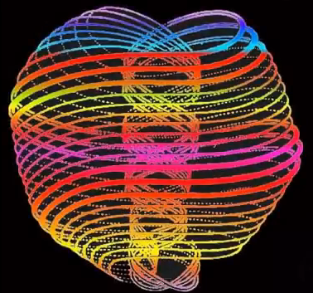
2nd examples: Quantum Matrix
Shor’s Algorithm (supercomputing)
Schrödinger's cat (probabilities)
Quantum foam (forms empty 3-space)
Distant spooky action (non-local correlations)
Tunneling (transistors, STM, …)
Lasers (quantum coherence)
Quarks, Bosons and Anu

Slide 18
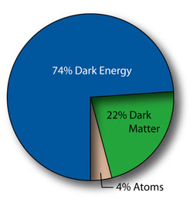
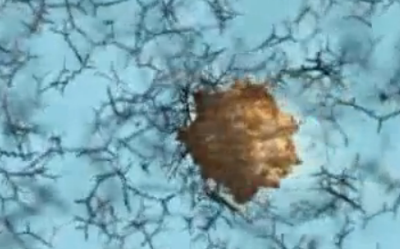
Higgs Boson and Dark Stuff
Higgs Boson is basis of mass (sticky qufoam)
Mass warps spacetime
Acceleration acts like gravity (injects noise)
Black Holes = gravity + quantum + entropy + bits
Since dark matter/energy is 96%, Galaxies form
Higgs and Dark matter/energy are entangled

Slide 19


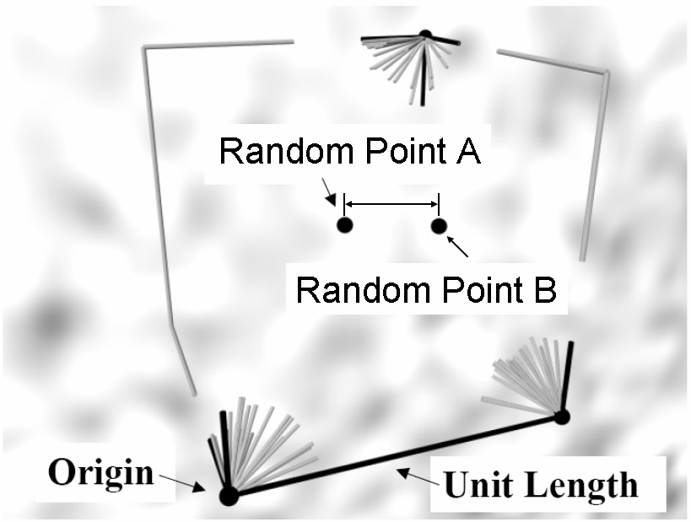
3rd concept: Law of Attraction is based on meaning
Attraction based on Thoughts/Meaning
What is representation for thoughts?
What is formal representation for meaning?
Math of Content Addressable Memory
Based on points in High Dimensional Memory
Thought Point A
Thought Point B
Corner?
inclusion box

Slide 20
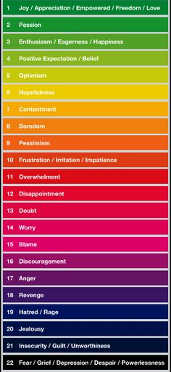

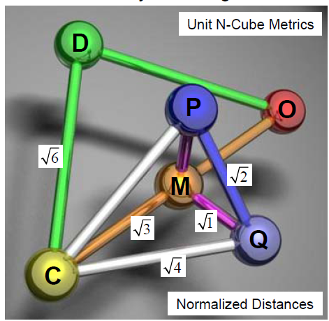
3rd examples: Meaning Attraction
Content Addressable Memories
  “Points of Meaning” self assemble
  Meaning is NOT in the brain
Meaning/Decision Cycle
  → Emotion → Memory →Thoughts →
Emotional ladder and vortex

Slide 21
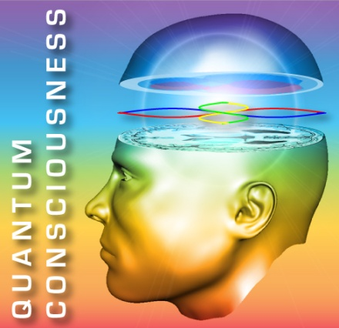

4th concept: we have a quantum mind & our brain is a transceiver
Meaning Mind is set of dimensions (source)
Thoughts are Quantum things
Non causal/a-temporal behaviors is primary clue
Non-local spatial behaviors (Remote Viewing, …)
Mind’s eye forms Dreams, NDEs and OBEs

Slide 22
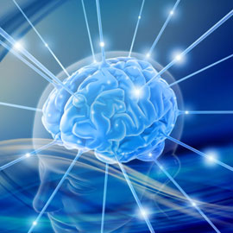
4th examples: Quantum Mind
Thoughts are Quantum Things
  Empathic and Telepathic
  Staring and Remote Staring
A-Temporal Behaviors
  10,000 pictures
  Presentience and Retrocausation
  Precognitive Remote Viewing

Slide 23
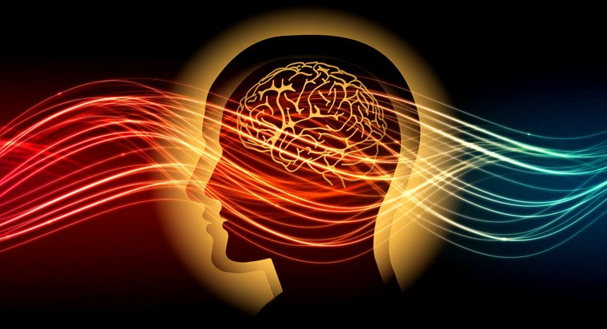
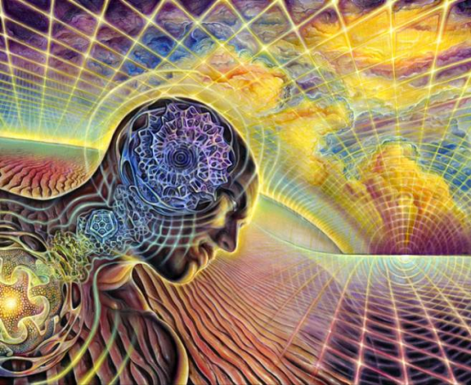
5th concept: our mind directly interacts with the physical world
Universe is a Quantum form of “the Matrix”
Mind and everything are quantum probabilities
Dimensional strands is source of “It” and “us”
Probabilities act as entropy change and energy
Thought changes probabilities in Brain
Entanglement makes two “things” act as one
Oneness is reality and separation is an illusion

Slide 24
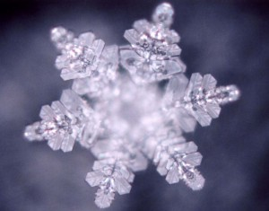
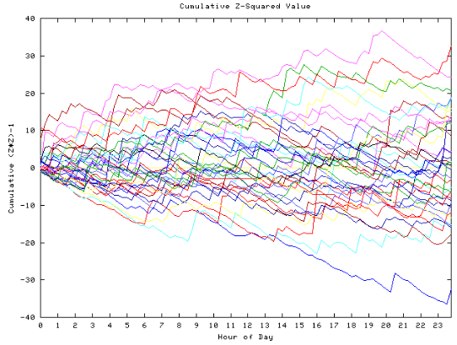
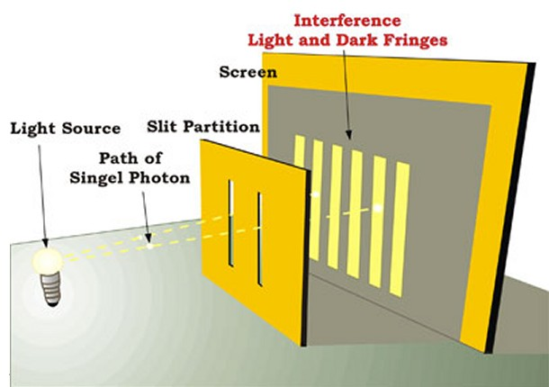
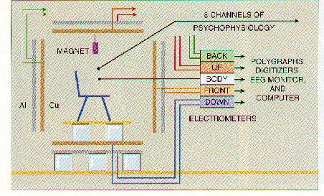
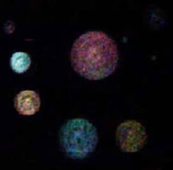
5th examples: Mind affects World
Intention and Attention
Consciousness effects water (& Ph)
Consciousness effects Electronics (9-11)
Global Consciousness & REG/PK
Twin slit PK experiment
Copper Wall (thought coherence)
Meditation and Siddhis (hopping)
Orbs are structured thought

Slide 25

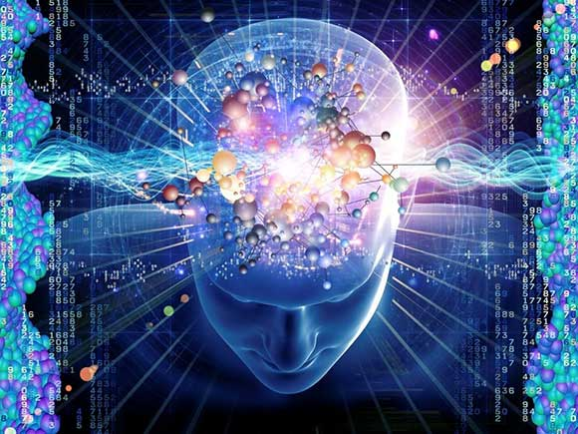
6th concept: our mind exists outside classical space and time
Mind’s Eye as high dimensional observer frame
Rotes as quantum “thought” packets of source
Time warp during peak experiences
Panoramic Time during NDEs
Presentience, retrocausation and precognition
Dreams, OBE, Past Lives
Thoughts are apparently “Faster Than Light”

Slide 26
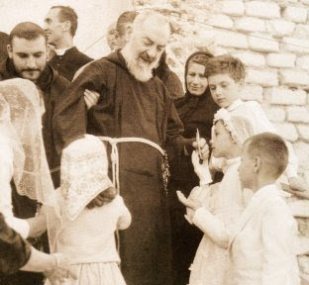
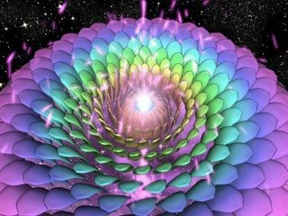
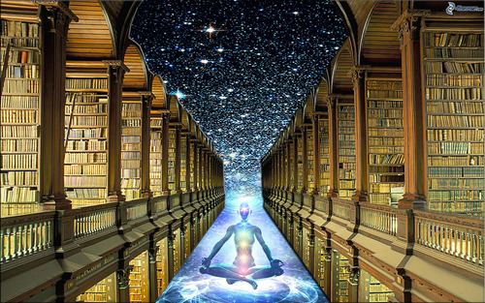
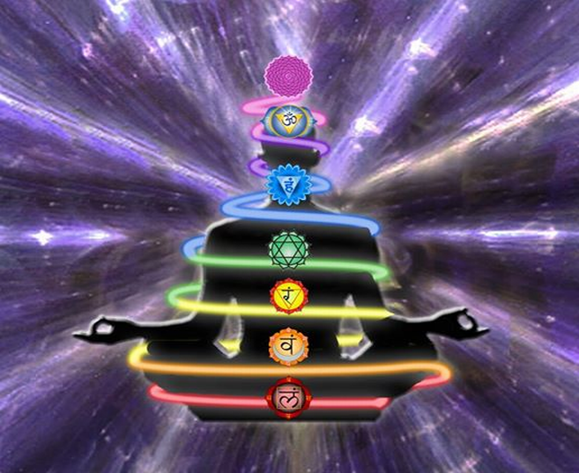
6th examples: Quantum Thoughts
Chakras have increased complexity (lotus petals)
Timeline Therapy
Remembering Past Lives
Teleportation and Bilocation
Akashic Records
No thought
Manifestation

Slide 27
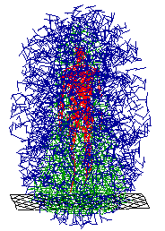
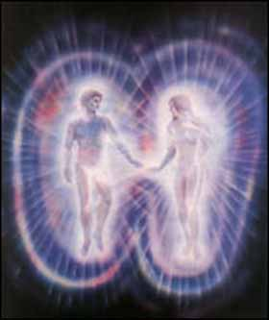
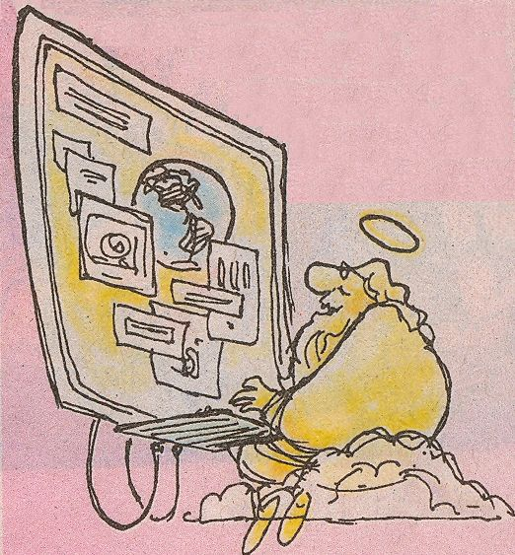
7th concept: we are quantum spiritual beings of light
We “see” source dimensions as Auras (qucloud)
We are eternal beings (no spacetime)
Aka Cords are entangled states
Chakras are gateways for Chi
All dimensions represents God

Slide 28


7th examples: Light Beings
Chakras and Kundalini (complexity building)
Internet is physical form of quantum rotes
Direct knowing is information based
Meaning only exists in Quantum Mind
Mind’s eye directs attention and intention
God is all powerful & all knowing (we are god)

Slide 29



Develop your own superpowers
1 Build Your Beliefs
  Believe quantum superpowers are normal
  Based on source thought bits not “energy”
  Discreetly discuss & know others’ superpowers
  Identity and practice your own superpowers

Slide 30



Develop your own superpowers (cont)
2 Quiet Mind and Focus Thoughts
  Quiet and slow your thoughts with mediation plus know your own mind
  Recognize and acknowledge thoughts that are not your own, even in dreams
  Focus and attract only desired thoughts then expect to attract synchronistic results

Slide 31



Develop your own superpowers (cont)
3 Choose Positive Emotions
  Choose positive emotions, thoughts, words and actions, since emotion affects memory
  Release trapped negative emotions and open up by dropping emotional shields
  Know and accept that all emotions will seem amplified and more alive. Chose grace

Slide 32



Develop your own superpowers (cont)
4 Build increasing chi flows
  Build chakra chi flow by grounding, breathing and heart opening
  Study energy techniques like Tai Chi, yoga, reiki, breathwork, EFT, …
  Create sacred conditioned spaces with clearing, altars, artwork and protective grids

Slide 33

Chakras link to Emotions/Memory
Increasing complexity
Increasing density

Slide 34




Chakras Control Chi Flow

Slide 35

Exercise to Build Your Chi Field

Slide 36



Develop your own superpowers (cont)
5 Use your superpowers for good
  Have more grace and be more attentive, intuitive, telepathic & open hearted with others
  Be “like the light” by stepping out of time and achieving panoramic supermind
  Expect help from physical and non-physical teachers, plus offer help when guided

Slide 37



Quantum Protophysics
my passion and my superpowers
Left Female
Right Male

Slide 38

Summary and Conclusions
Our Quniverse is built on high dimensions
Bits, entanglement & no spacetime is the norm
Classical world is running on this quantum matrix
Protophysics/Qubit/ebit basis for superpowers
Believe, expect and develop your superpowers
We are eternal spiritual beings with quantum mind

Slide 39

Questions and Discussion
What’s YOUR Superpower?

